Slide 1
Prévisions météorologiques
Mesures et données
Bertrand Calpini
CRP 2015 – September 2015
WMO

Slide 2
CIMO mission
Promote:
  high quality observational data
  world-wide compatibility
by:
  Defining technical standards,
  Testing and calibration
  Performing instrument intercomparisons,
  Implementing quality control procedures.
  Increasing expertise and Capacity-building

Slide 3
Standardization vs Human Observers
New cloud classifications
New imagery
New Cloud Identification Aids
Glossary
Web-based structure
Plan:
  End of 2015: All material assembled
  End of 2016:
  The new 2016 International Cloud Atlas:
  a web-based, multi-functional tool.

Slide 4
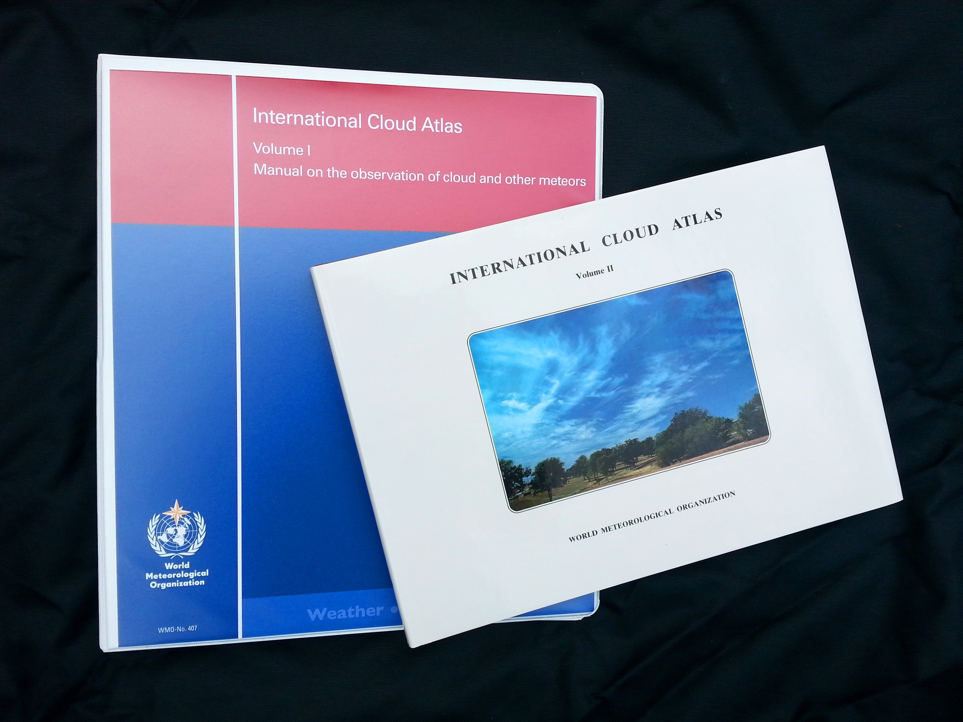
Notes:
These editions from 1975 and 1987 constitute the current ICA
Volume 1 – consists of 3 main sections.
A general classification of meteors.
definitions of clouds: genera, Species, Varieties, Supplementary features, Accessory Clouds, Mother-clouds.
Definitions of meteors other than clouds: - Lithometeors (dust, haze), Photometeors (optical phenomena), Electrometeors (lightning)
Parts of Volume 1 constitute WMO Technical Regulations.
The ICA is the global standard for cloud classification. It is a primary global training aid for professional weather observers.
But.... Volume 1 hasn’t been updated in 40 years, and Volume 2 in almost 30 years.
There have been many advances in the last 30 – 40 years in meteorology and the world generally. The latest revision, Volume 2, was published before the advent of digital cameras and the Internet.
A review of the Cloud Atlas is needed !

Slide 5
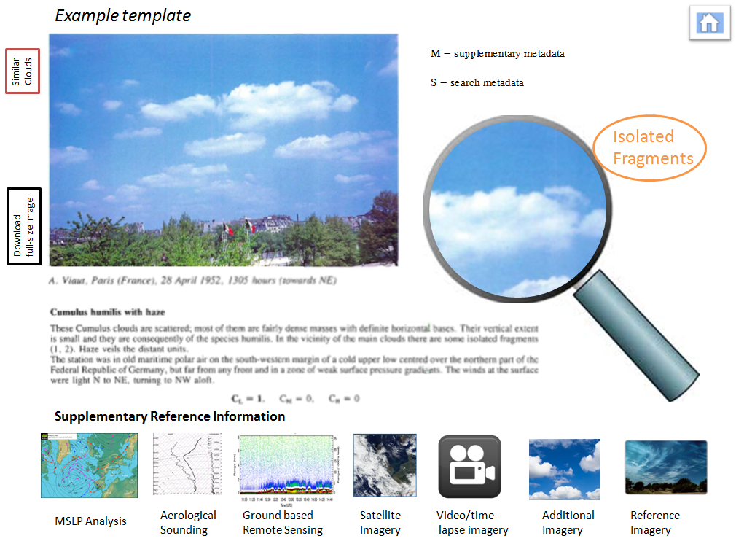
A proposed template for the new ICA
Notes:
We propose:
Ability to utilise the technology to isolate / zoom in on important features.
Ability to search metadata.
Ability to download the image.
Ability to search similar clouds.
Original Reference Images from the 1987 edition will be retained to preserve traceability to the known standard.
New ability to access (where appropriate and available) supporting data: - synoptic charts, upper-air soundings, radar, lidar, satellite images, video and time-lapse photography.
We will seek copyright permission from the relevant organisations.

Slide 6
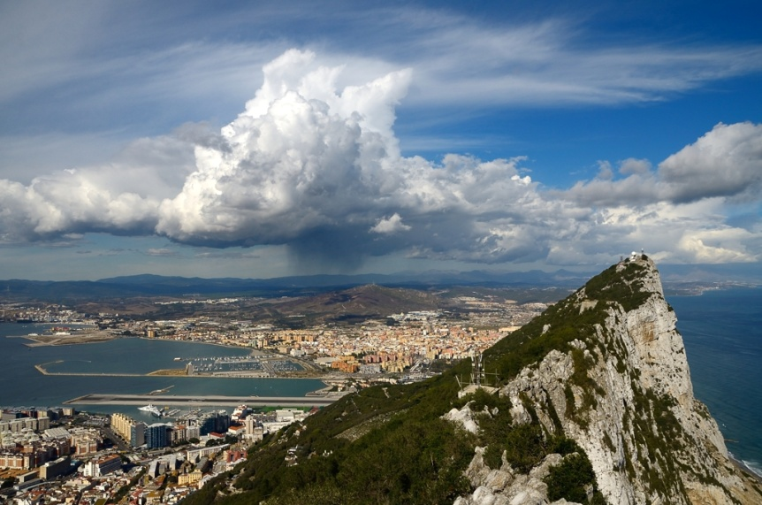
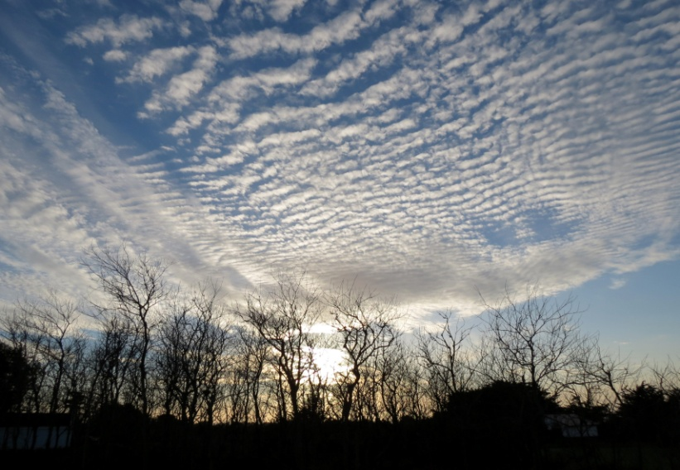
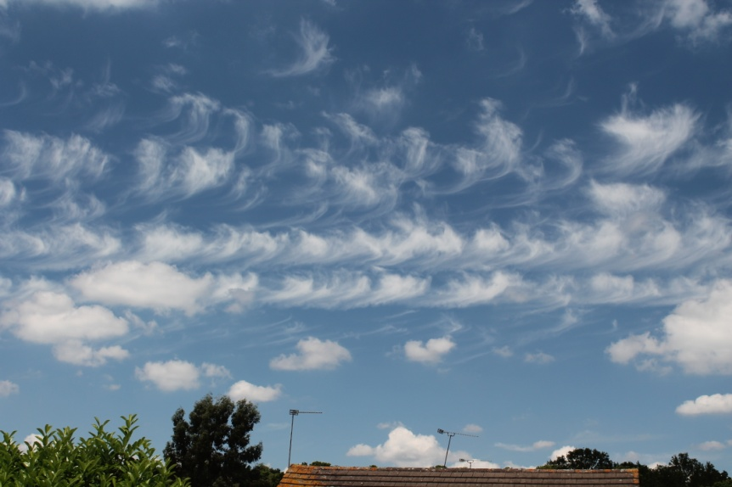
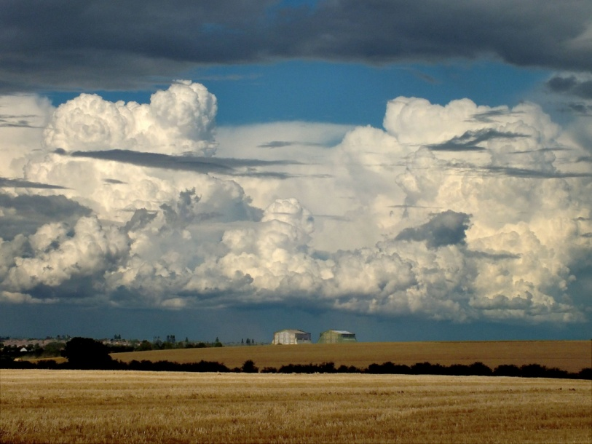
Improvements: better images
Notes:
Volume 2 published in 1987 pre-dates the use of digital cameras and the Internet which has made the ability to transmit images around the world easy.
We will use the best, high-quality digital images from around the world in the updated Cloud Atlas.

Slide 7
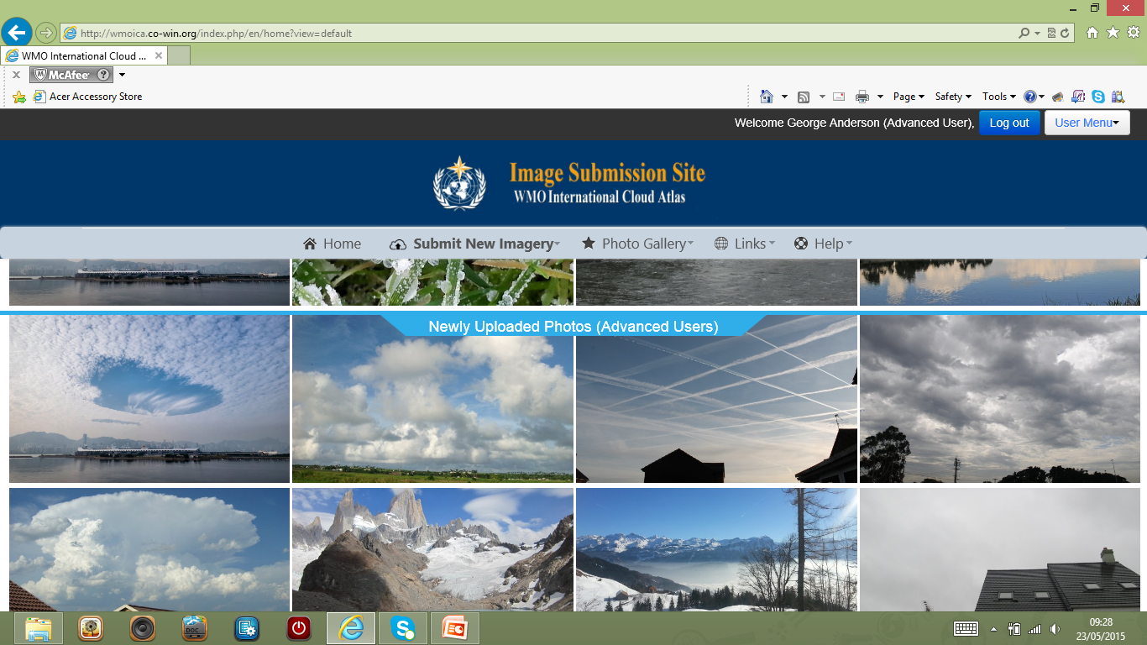
Image submission website
Notes:
Using the Image submission site we will collect digital photographs and associated metadata, including time-lapse photography, from people all around the world.
This will allow the Task Team to select for the Cloud Atlas: the best images to illustrate the classifications, and a world-wide distribution (the current Atlas contains largely photos from Europe).

Slide 8
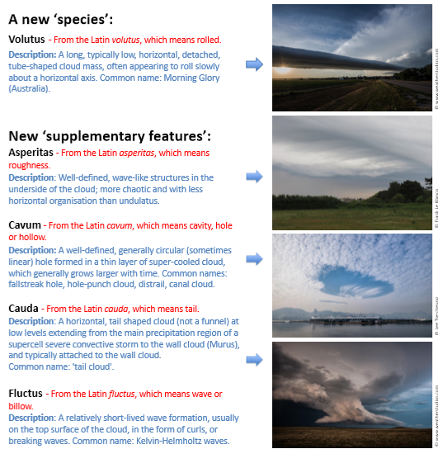
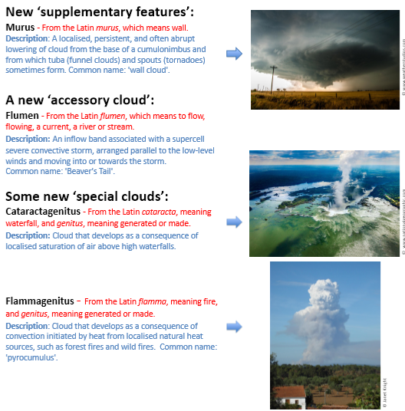
New cloud classifications
Notes:
We propose the addition of several new classifications: (The Latin names have been confirmed with a Latin expert)
Volutus will correct an anomaly. Roll cloud is classified as an arcus, but arcus is attached to parent cloud. Roll clouds are solitons.
We accept CAS proposal for Asperatus, as this is not covered by undulatus classification, but will use the Latin Asperitas.
We propose that special features: Kelvin-helmholtz waves, fallstreak holes/hole-punch clouds be added as supplementary features.
We propose that special clouds be classified – e.g. Pyrocumulus - using a new Mother-cloud term ‘flammagenitus’
We accept proposal for man-made clouds to be classified, but will use Latin nomenclature within Mother-cloud part of classification, rather than Greek ‘anthropo-’
We propose that certain specific, important features associated with severe convective storms be classified as supplementary features of accessory clouds - e.g. The wall cloud (from which tornadoes form), tail cloud, and inflow band. This follows consultation with NOAA NSSL.
These new classifications will give ‘official’ names to features previously known by only common names, and in some cases by several common names.

Slide 9
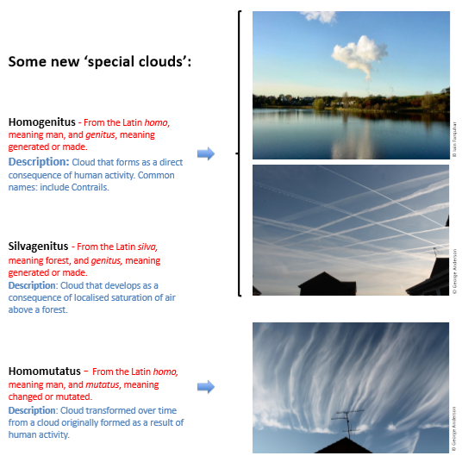
New cloud classifications

Slide 10
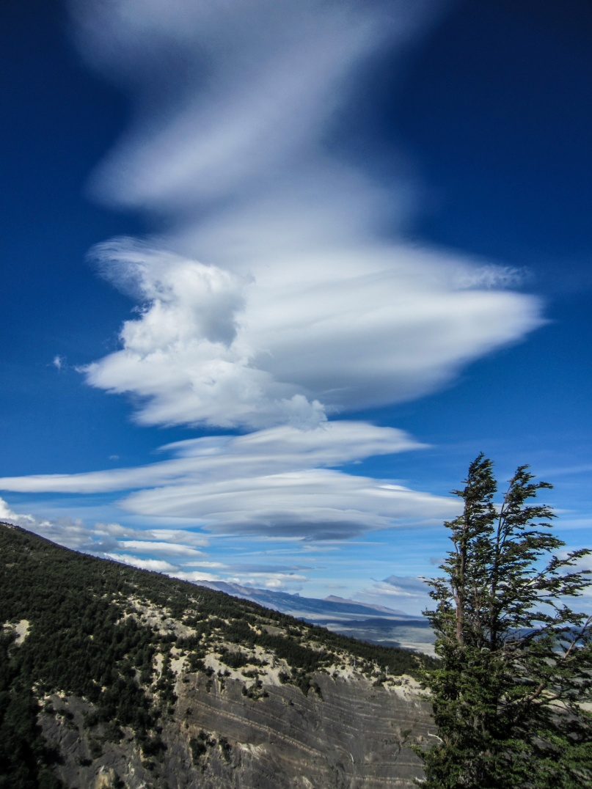
The new International Cloud Atlas …..
Will be the most comprehensive, global
reference document on the classification and
observation of clouds and other meteors.
Will be available to professionals and the
wider public through the Internet.
Will provide professionals with a digital
training aid in modular form including text,
photographs and supplementary data.
Will maintain global standardisation of
observation.

Slide 11
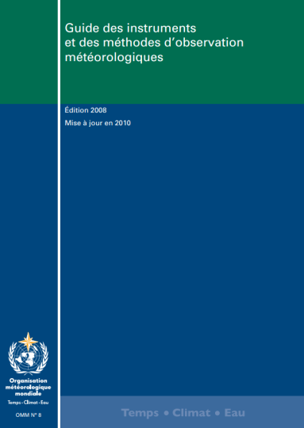
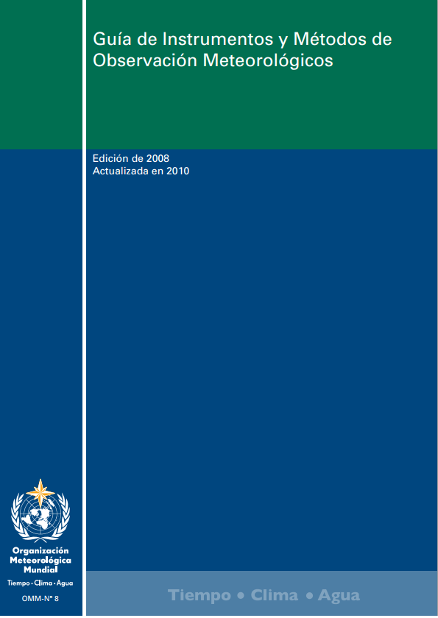
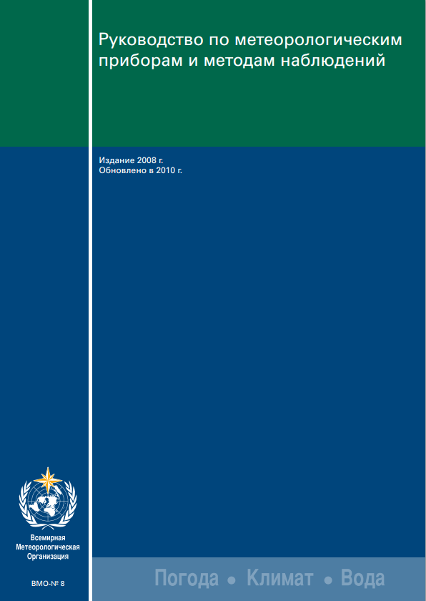
Standardisation and CIMO Guide (5)
Merci
Gracias
Спасибо

Slide 12
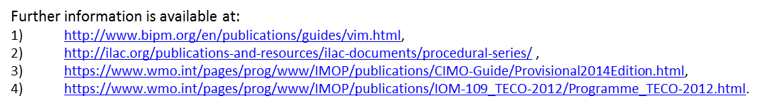
Is it true that a temperature measurement of 20 °C from one place and from one point in time can be compared to an identical measurement from a different location and/or time?
Only if each temperature measurement is metrologically traceable to a common standard

Slide 13
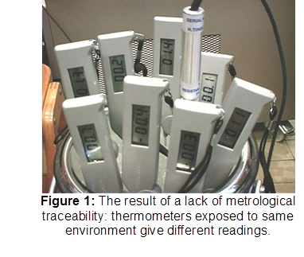

Slide 14
Figure 2: Metrological and meteorological hierarchy

Slide 15
measurement, what is it?
assignment of a number to a characteristic of an object or event, which can be compared with other objects or events
  Cornerstone of trade, science, technology, and quantitative research in many disciplines.
the science of measurement is pursued in the field of metrology.
standards defined by International System of Units (SI).
  all physical measurements are reduced to a mathematical combination of seven base units.

Slide 16
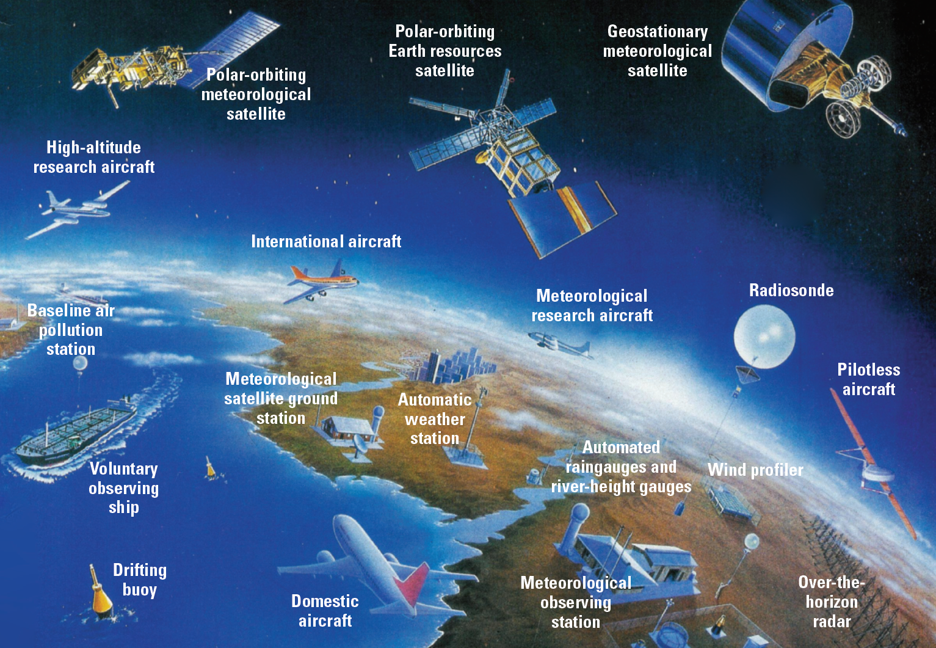
surface measurements part of an wide observing system

Slide 17
Measurement technology deals with
sensor technology
  how to get an electrical signal to automate a measurement process
signal digitalization
  how to get an number from the electrical signal
signal processing
  how to get an value of interest from the digitized signal
instrument design
  to minimize measurement uncertainty
  to minimize maintenance requirements
  to ensure proper functioning in harsh conditions (icing, storm, lightening, …)

Slide 18
sensor characteristics
  observed physical quantity
  measuring range
  sensitivity ; 10uV/(W/m^2)
  resolution ; 0.1°C
  accuracy – reproducibility
  linearity, response time, bandwidth, hysteresis
  operating temperature range

Slide 19
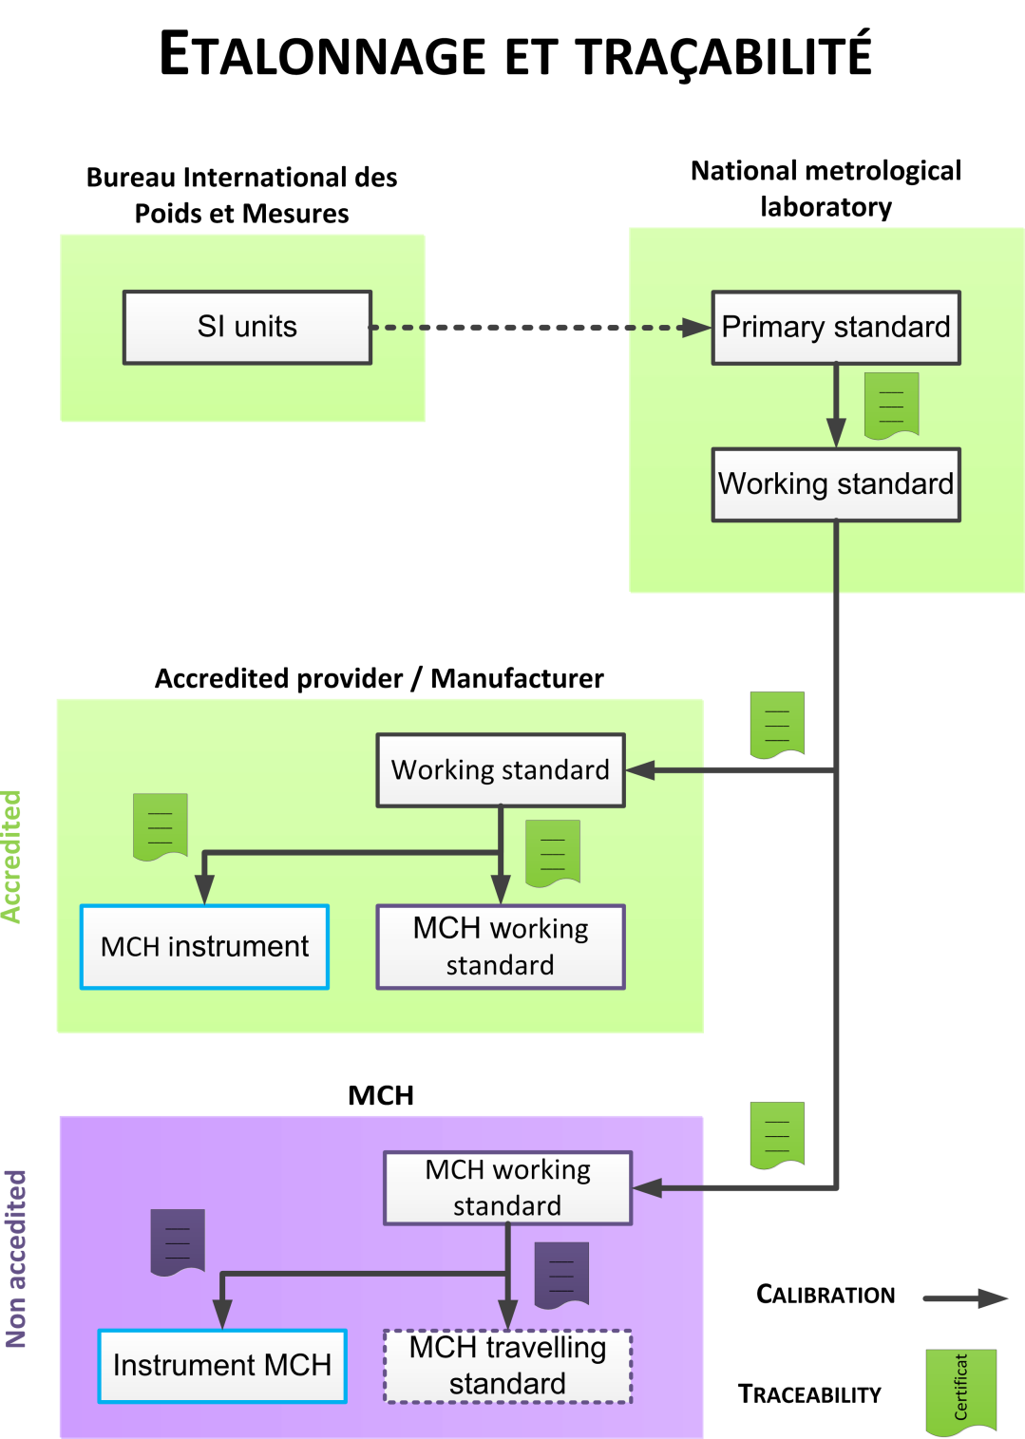
traceability
possibility to prove the precision of an instrument via the certificates of calibration bodies
calibration concept
calibration method
calibration procedure
certificate

Slide 20
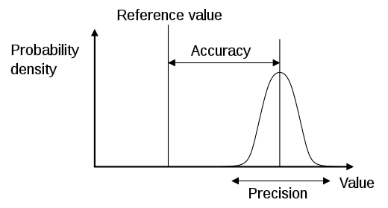
three sources of uncertainty
Uncertainty
systematic uncertainty
Bias
Resolution
instrument limitation
statistical distribution
weakly/strongly random

Slide 21
reducing the uncertainty
source | can be estimated via | can be reduced via
accuracy-bias | calibration, i.e. comparison to a reference with known accuracy | adjustment during calibration
precision- statistical distribution | standard deviation, RMSE | averaging
resolution | instrument specs | change instrument

Slide 22
sources of uncertainty example of temperature
small
Errors in international, national and working standards
Errors in the comparisons between working or travelling standards and the field instruments (depending on the skill of the operator, quality of the equipment, environment homogeneity);
Non-linearity, drift, repeatability and reproducibility in the field thermometer and its transducer (depending on the type of thermometer element);
Heat transfer between the thermometer element and the air in the thermometer shelter;
The effectiveness of the thermometer shelter, which should ensure that the air in the shelter is at the same temperature as the air immediately surrounding it.
The exposure, which should ensure that the shelter is at a temperature which is representative of the region to be monitored.
maintenance
Instrument design
often neglected

Slide 23
siting or representativity uncertainty
CIMO-Leroy siting classification
(in the case of temperature)

Slide 24
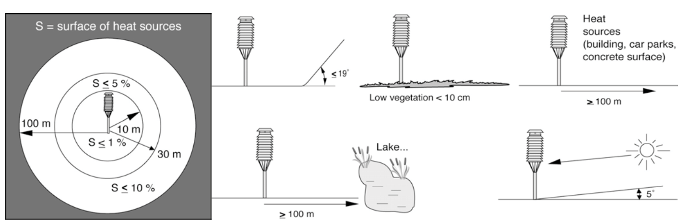
f) exposure or site representativity
CIMO-Leroy classification
Temperature class 1(conform to WMO recommendations)

Slide 25
METAS certification
SMN stations - CIMO-Leroy classification
20 SMN stations are evaluated per year
20 3rd party stations are evaluated per year
this uncertainty term has to be used to compare with other measurements types (e.g. satellites, neighboring stations, etc..)
some of class 4 stations are NBCN stations
this information is stored as metadata in DWH

Slide 26
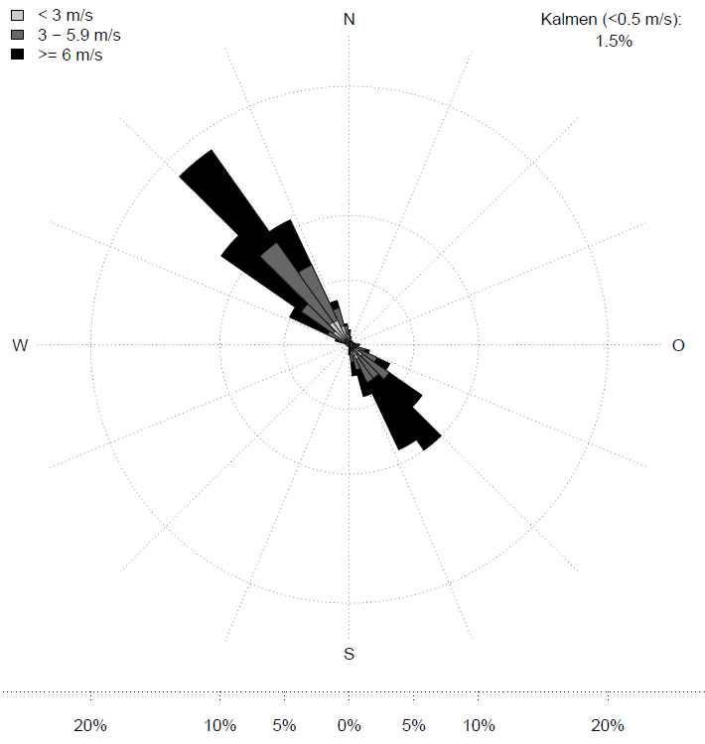
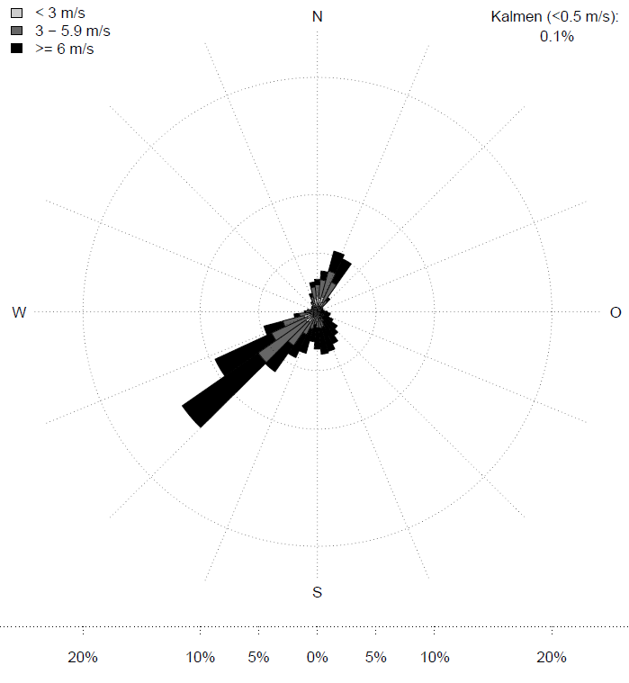
Representativity issues an example for wind measurement
windrose JUN
windrose DIA

Slide 27
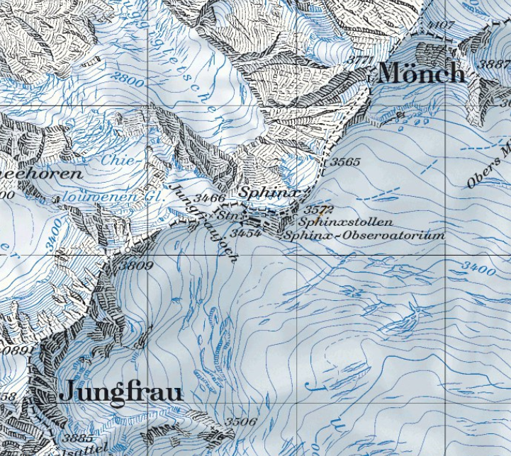
Measurements in mountain areas
Representativity issues
windrose JUN
windrose DIA
good practice:
adequately choosing the measurement sites

Slide 28
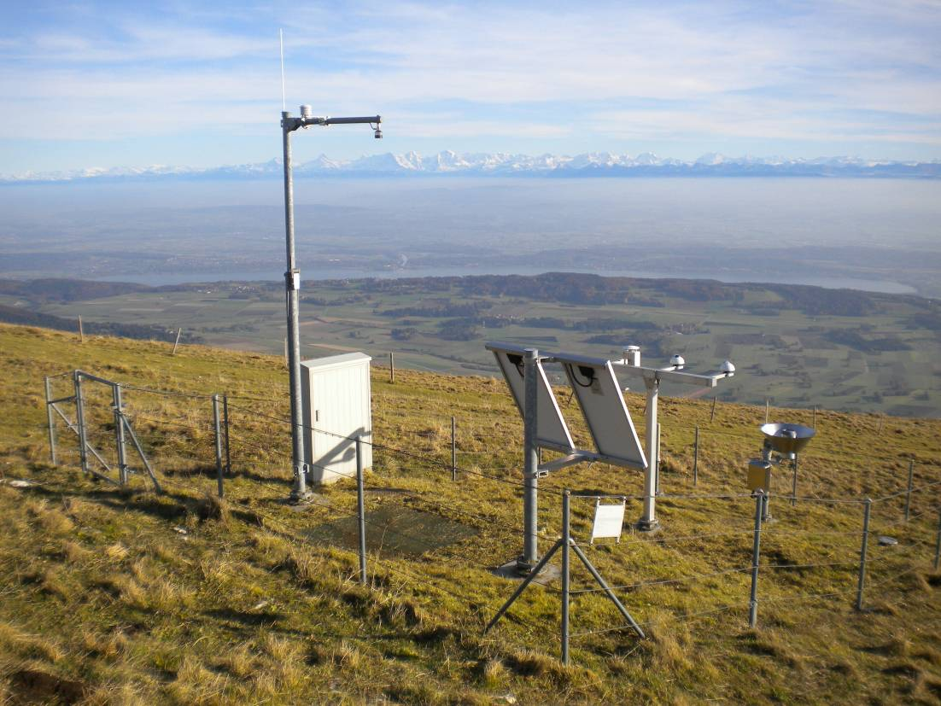
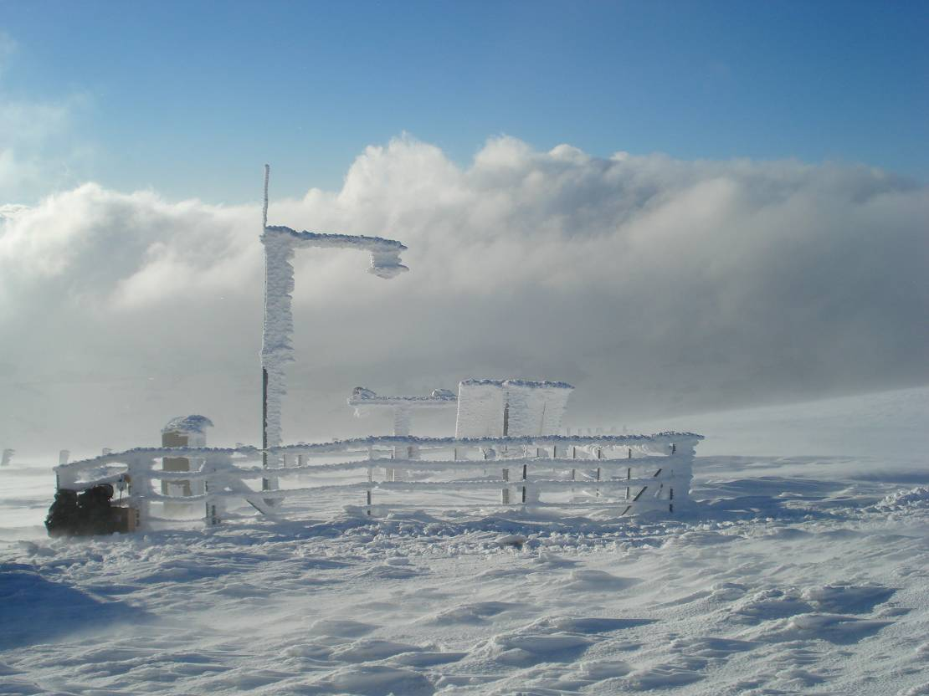
precipitation measurement example of representativity
Chasseral November 2010
slope 14° (< 19° ->Leroy class 1)
CHA – 16 novembre 2007
-10° / strong wind!

Slide 29
Radiation measurements
Surface based in situ observations
Radiosonde radiation budget

Slide 30
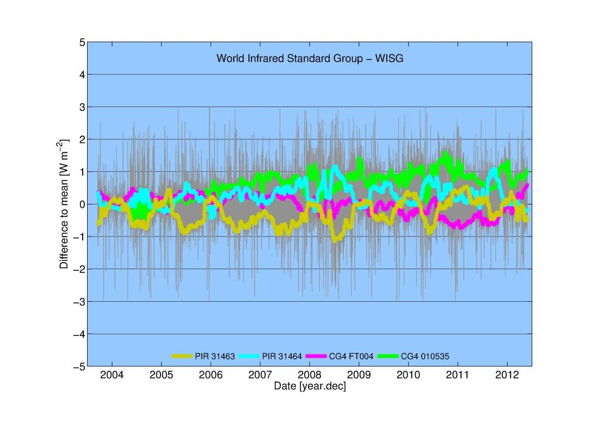
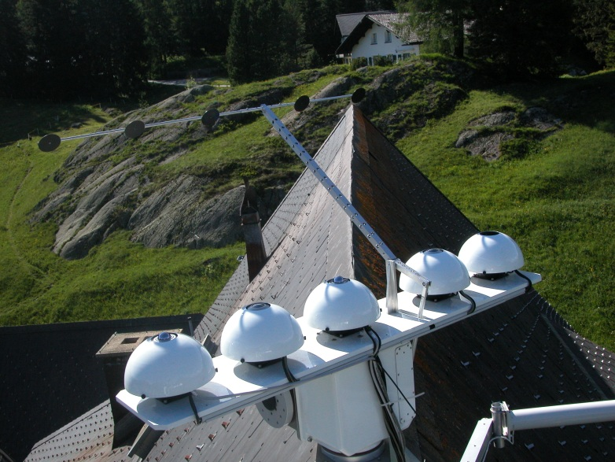
When the World was still simple,
Atmospheric emitted radiance interferometer
International Pyrgeometer
and Absolute Sky-Scanning Radiometer Comparison
Absolute Sky Radiometer
Radiative Transfer Models
1999, 2001 IPASRC-I, -II campaigns with Pyrgeometers, ASR, AERI, RTMs show agreement between various instruments and models to ±2 Wm⁻².
2004, Start of the Infrared Radiometry Section at PMOD/WRC and establishment of the World Infrared Standard Group of Pyrgeometers (WISG), traceable to the ASR via IPASRC-I.
1 Jan 2012
Adjustment of WISG 4 by 0.7%
WISG
WISG uncertainty ±2.5 Wm⁻²
CG4 010535
PIR 31464
CG4 FT004
PIR 31463

Slide 31
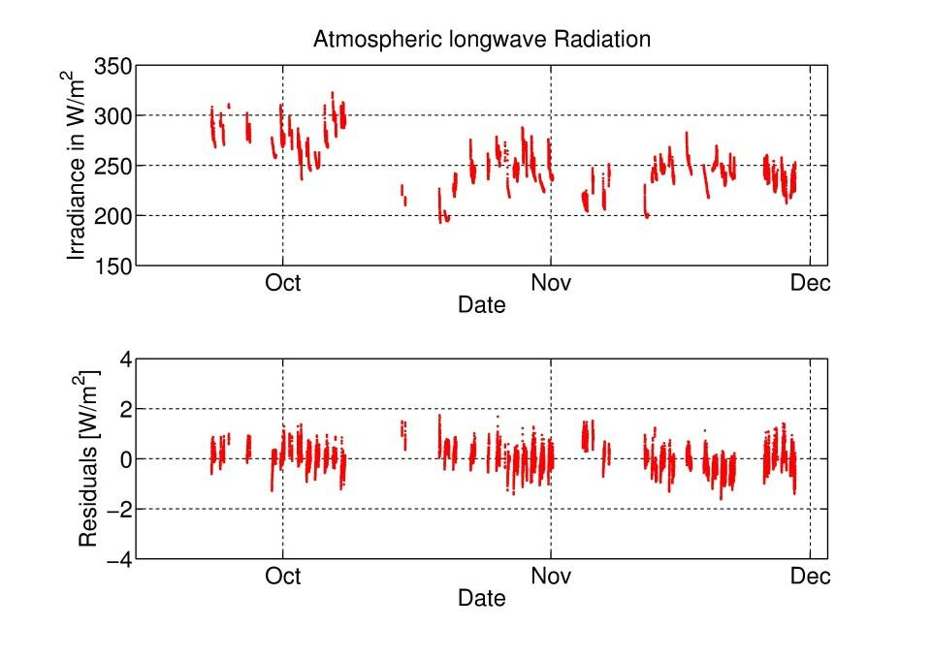
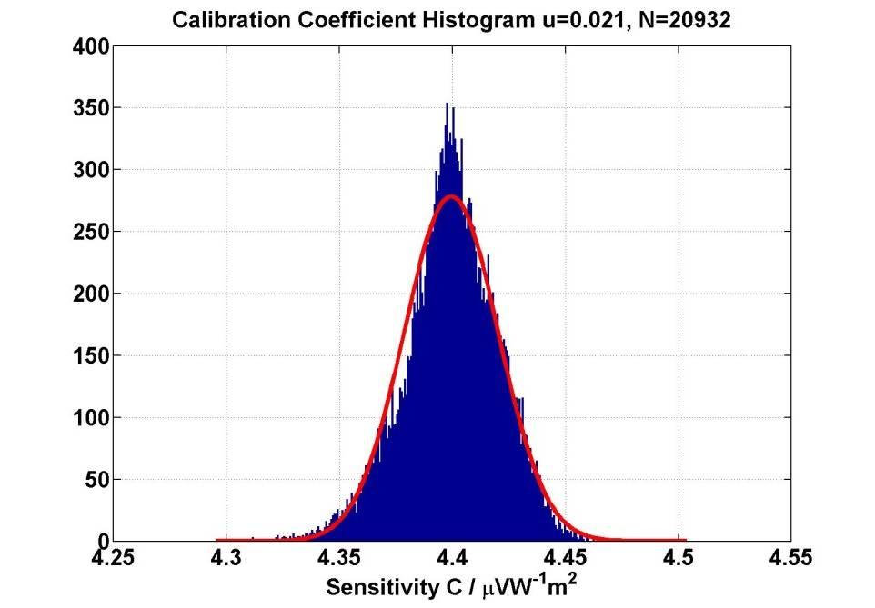
Pyrgeometer calibrations (when the world was simple)
Eppley PIR
95% of the Residuals are within ±1 Wm⁻²
Uncertainty of pyrgeometer calibration relative to:
  WISG 1.1%
  SI Wm⁻² 3.4
This calibration procedure works well for all Eppley PIR and worked well for Kipp&Zonen pyrgeometers (CG1, CG4, ...), until...

Slide 32
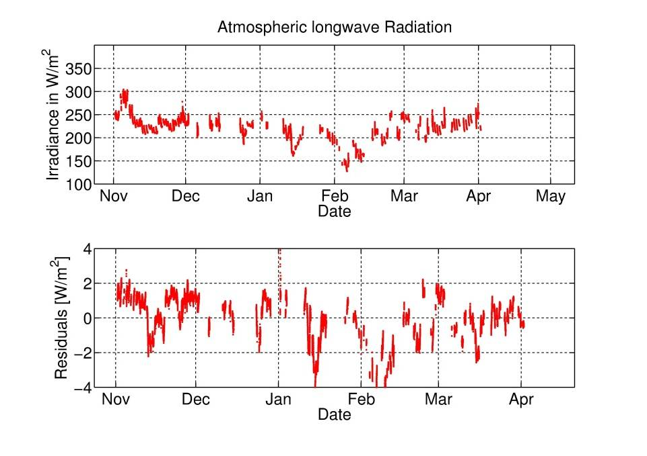
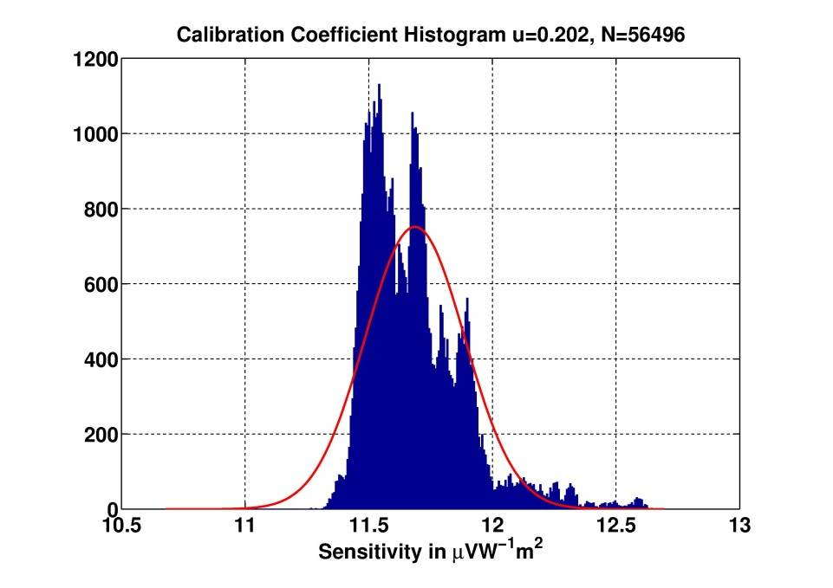
Then, the World became more complex
CG4 030669
95% of the Residuals are within ±3 Wm⁻²
Uncertainty of pyrgeometer calibration relative to:
  WISG 4.0%
  SI Wm⁻² 5.1
Conclusion : CG4 030669 is a "bad" instrument
(at the time, 2004)

Slide 33
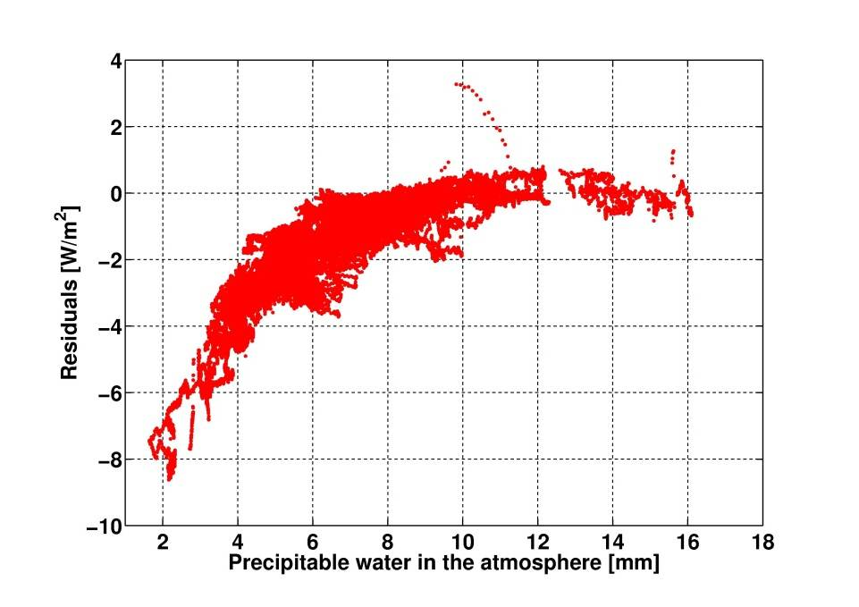
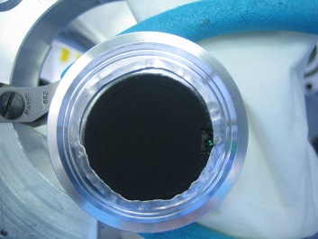
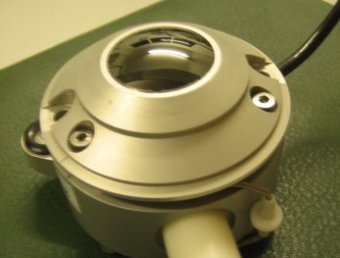
Interestingly, the residuals correlate with atmospheric water vapour
CG4 030669
Cold, Dry
Warm, Humid
The residuals show a seasonal dependence:
lower in winter,
higher in sommer,
and correlate very well with the atmospheric water vapour.
AND
"Strange" Behaviour could be linked to the silicon dome of this particular pyrgeometer

Slide 34
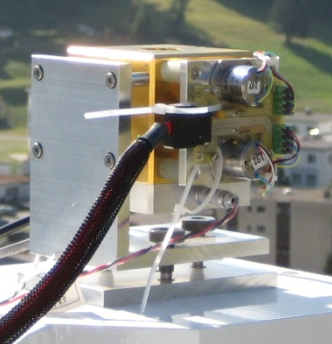
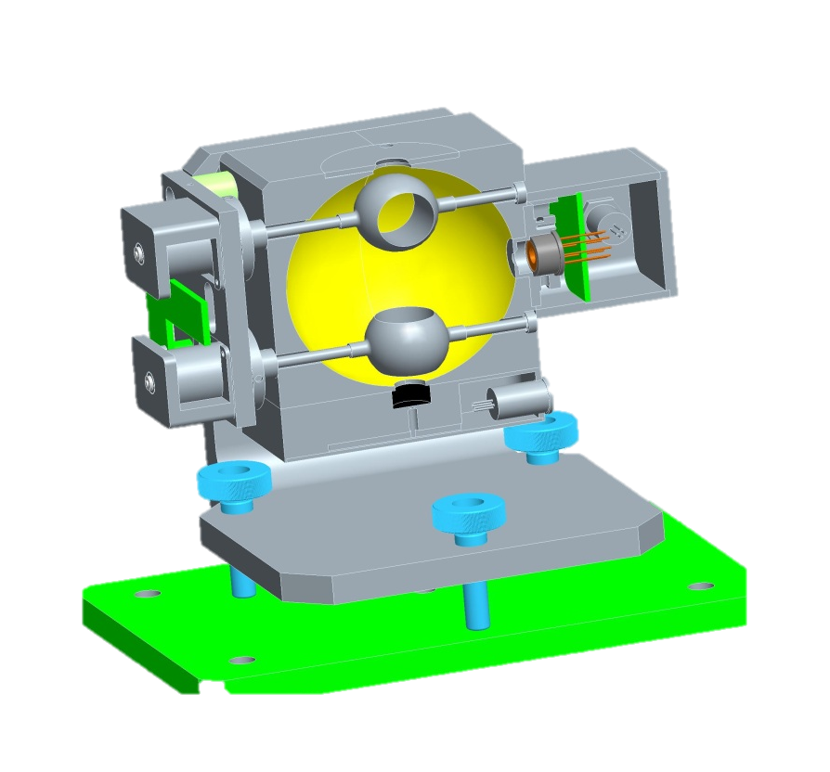
The Infrared Integrating Sphere (IRIS) Radiometer
Key features of the IRIS Radiometer
Windowless
Irradiance measurement by using a 60 mm gold-plated integrating sphere as input optic
High sensitivity from a windowless pyroelectric detector
Flat spectral response
Measurement frequency 0.1 Hz
Automatic unattended operation
Nighttime measurements only
Aperture
Detector
Shutter
Reference surface
IRIS Uncertainty
U95%= 1.8 Wm⁻² summer (+15°C)
2.4 Wm⁻² winter (-15°C)
Gröbner, Metrologia 49 (2012) S105-S111

Slide 35
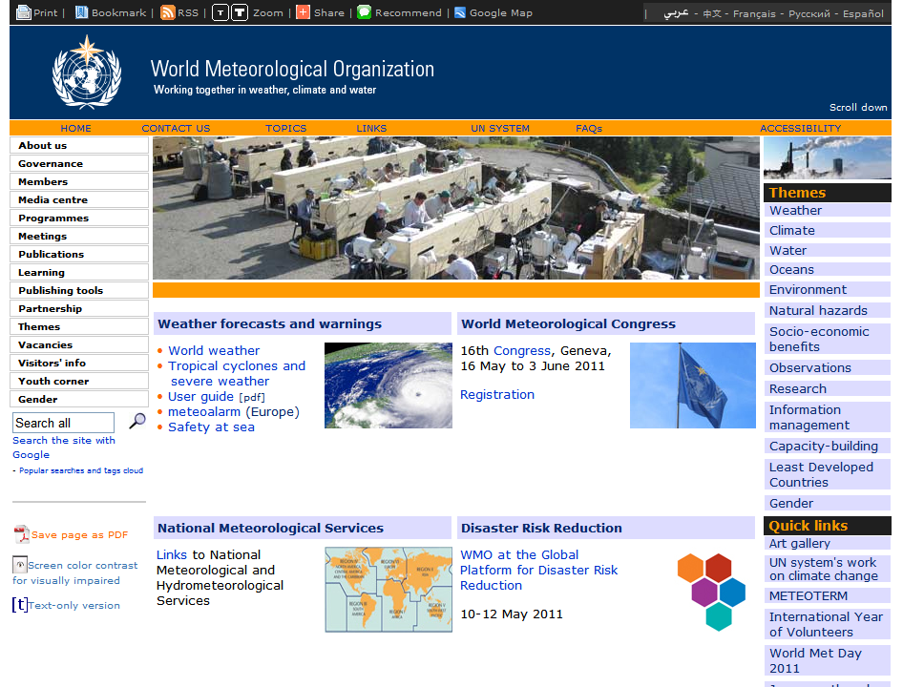
4. Radiation
27. September – 15. October 2010, PMOD/WRC Davos, Switzerland

Slide 36
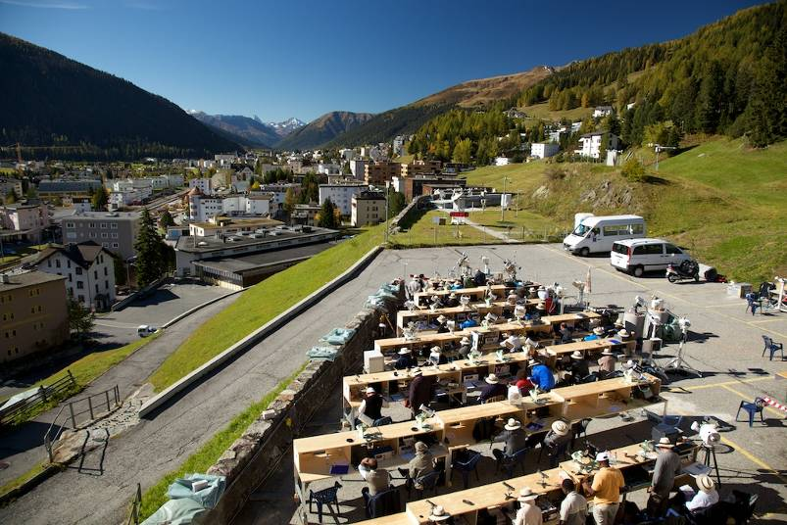
87 participants
40 countries
99 pyrheliometers
Next IPC this automn 2015

Slide 37
Radiosonde
8th WMO International Radiosonde Comparison.
Yangjiang, Guangdong, China
12 July – 3 August 2010
Participants:
11 manufacturers from
China, Finland, France, Germany, Japan,
Korea, South Africa, Switzerland, USA
Film sondage 03-meteo_suisse_kelly.avi
Notes:
37

Slide 38
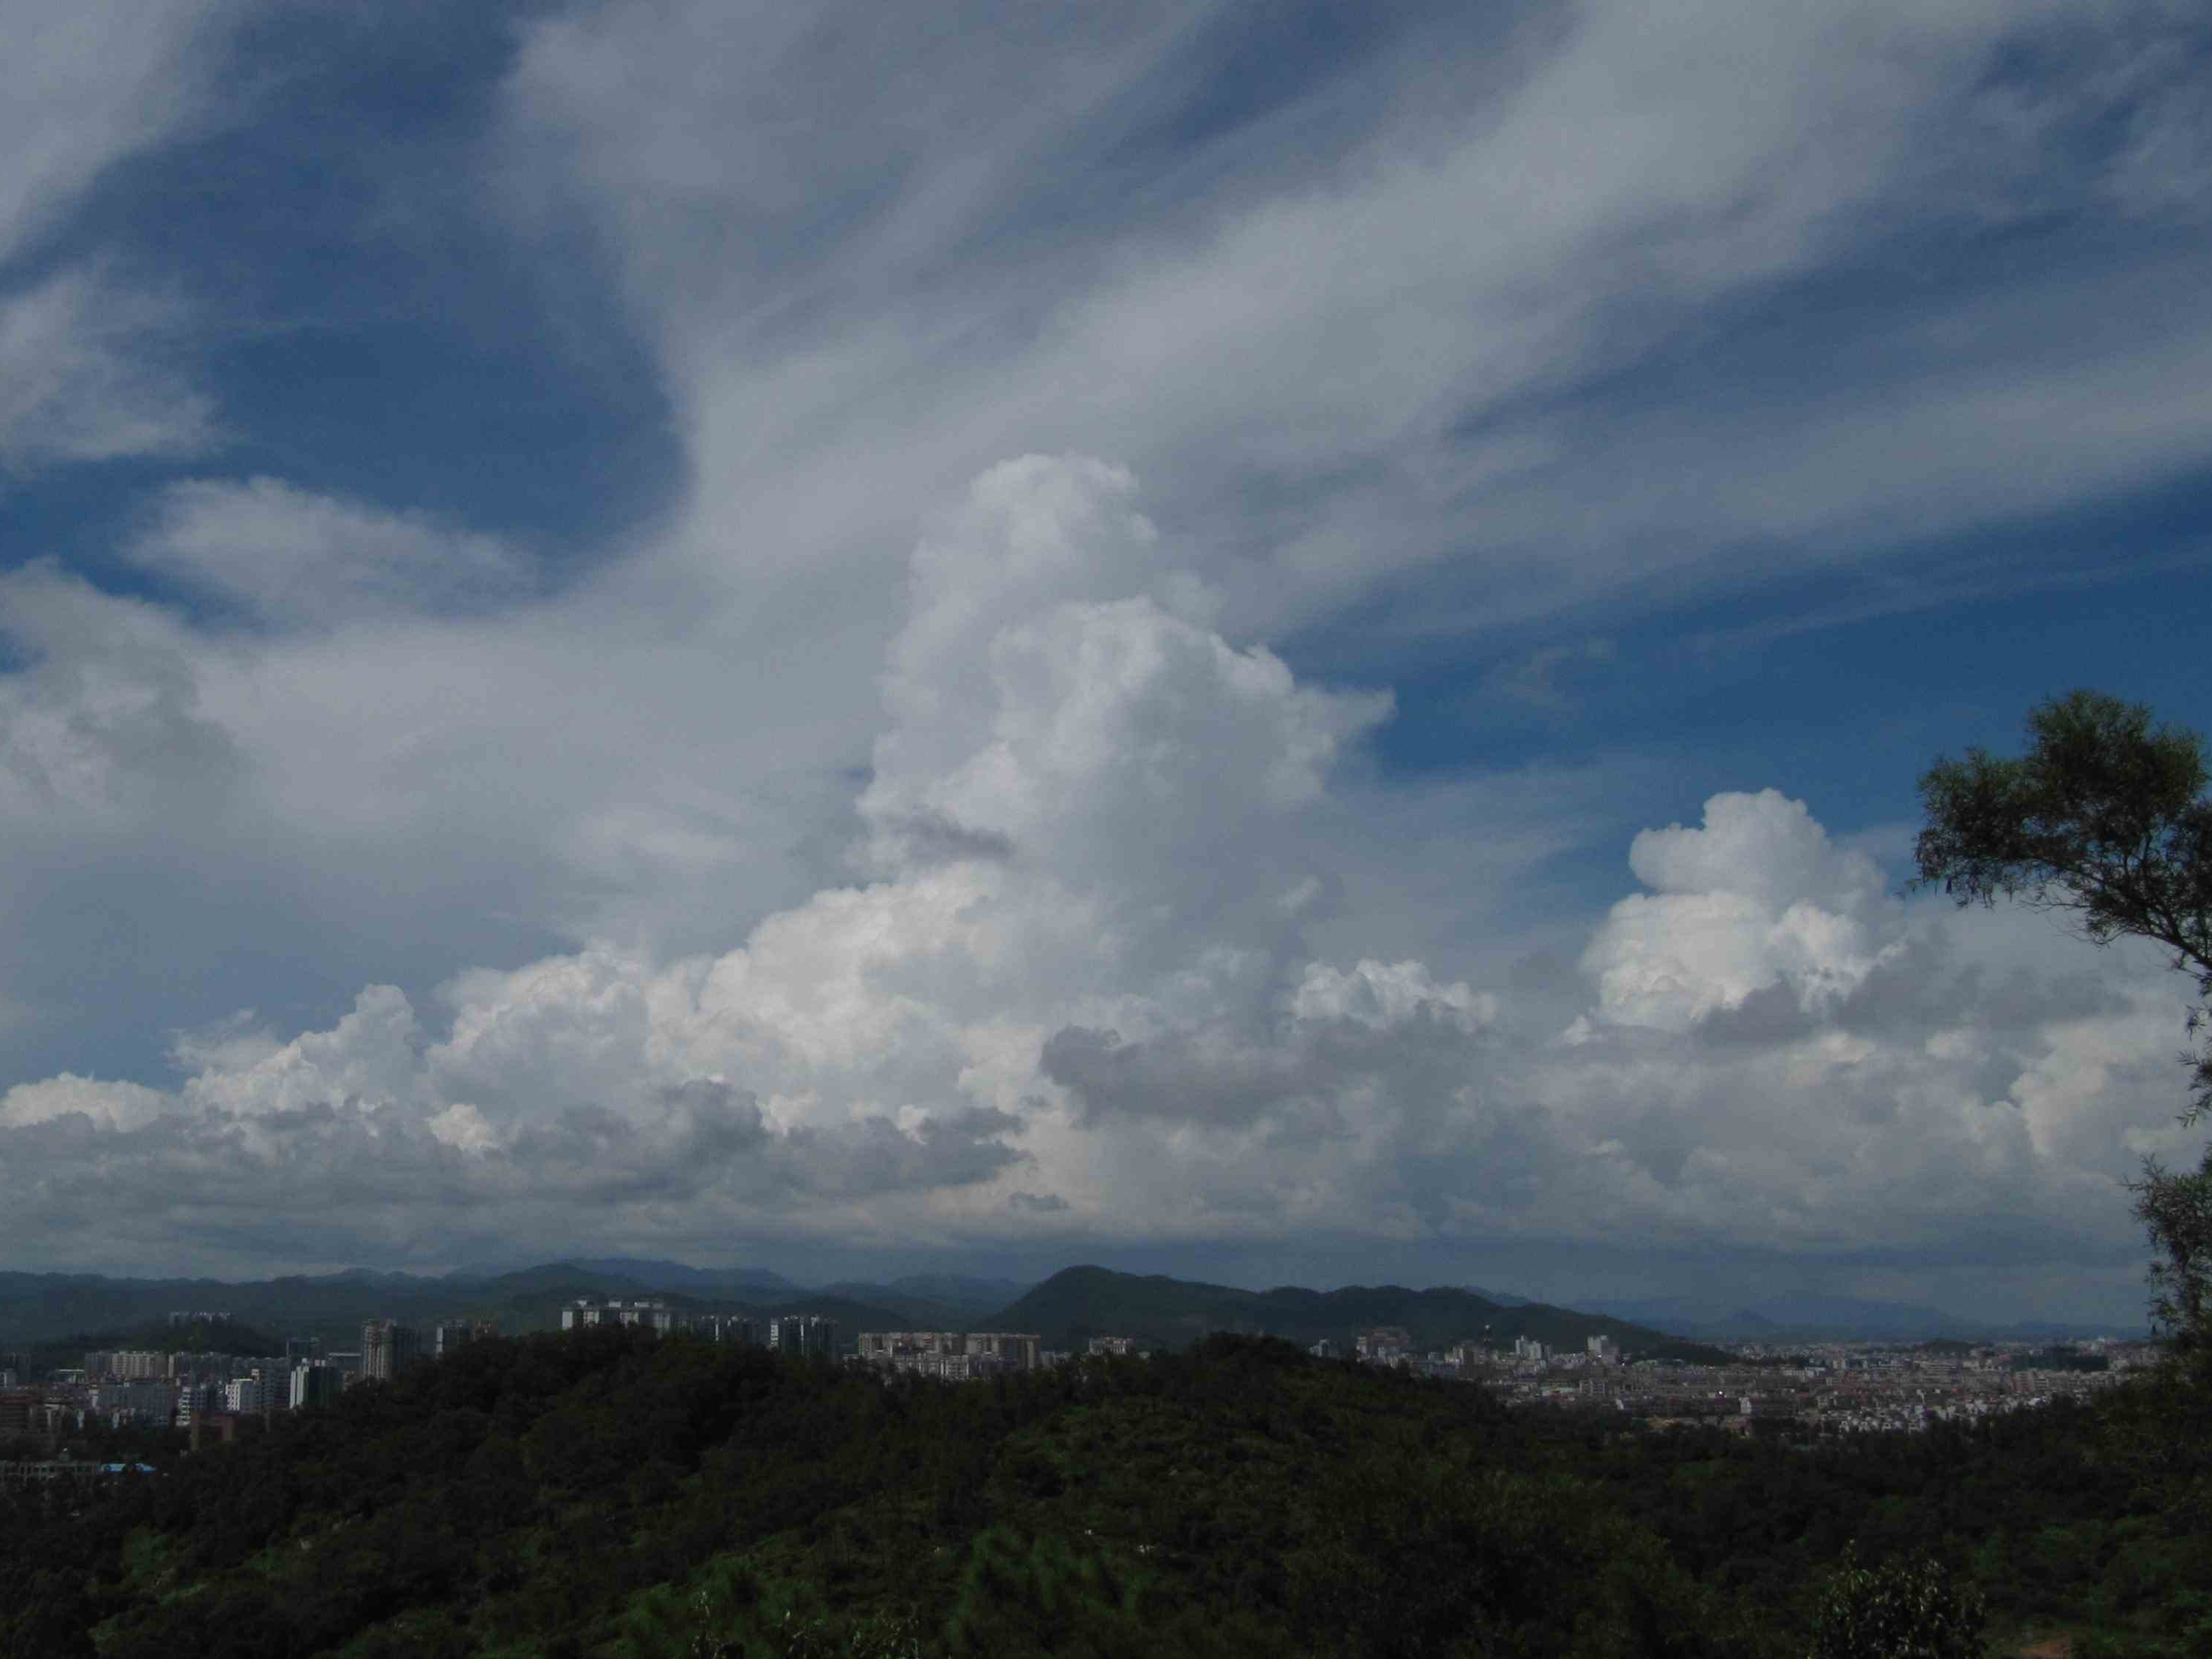
Tropical/subtropical moist conditions
Tropopause & 16km
Temperature >> -90deg
Notes:
38

Slide 39
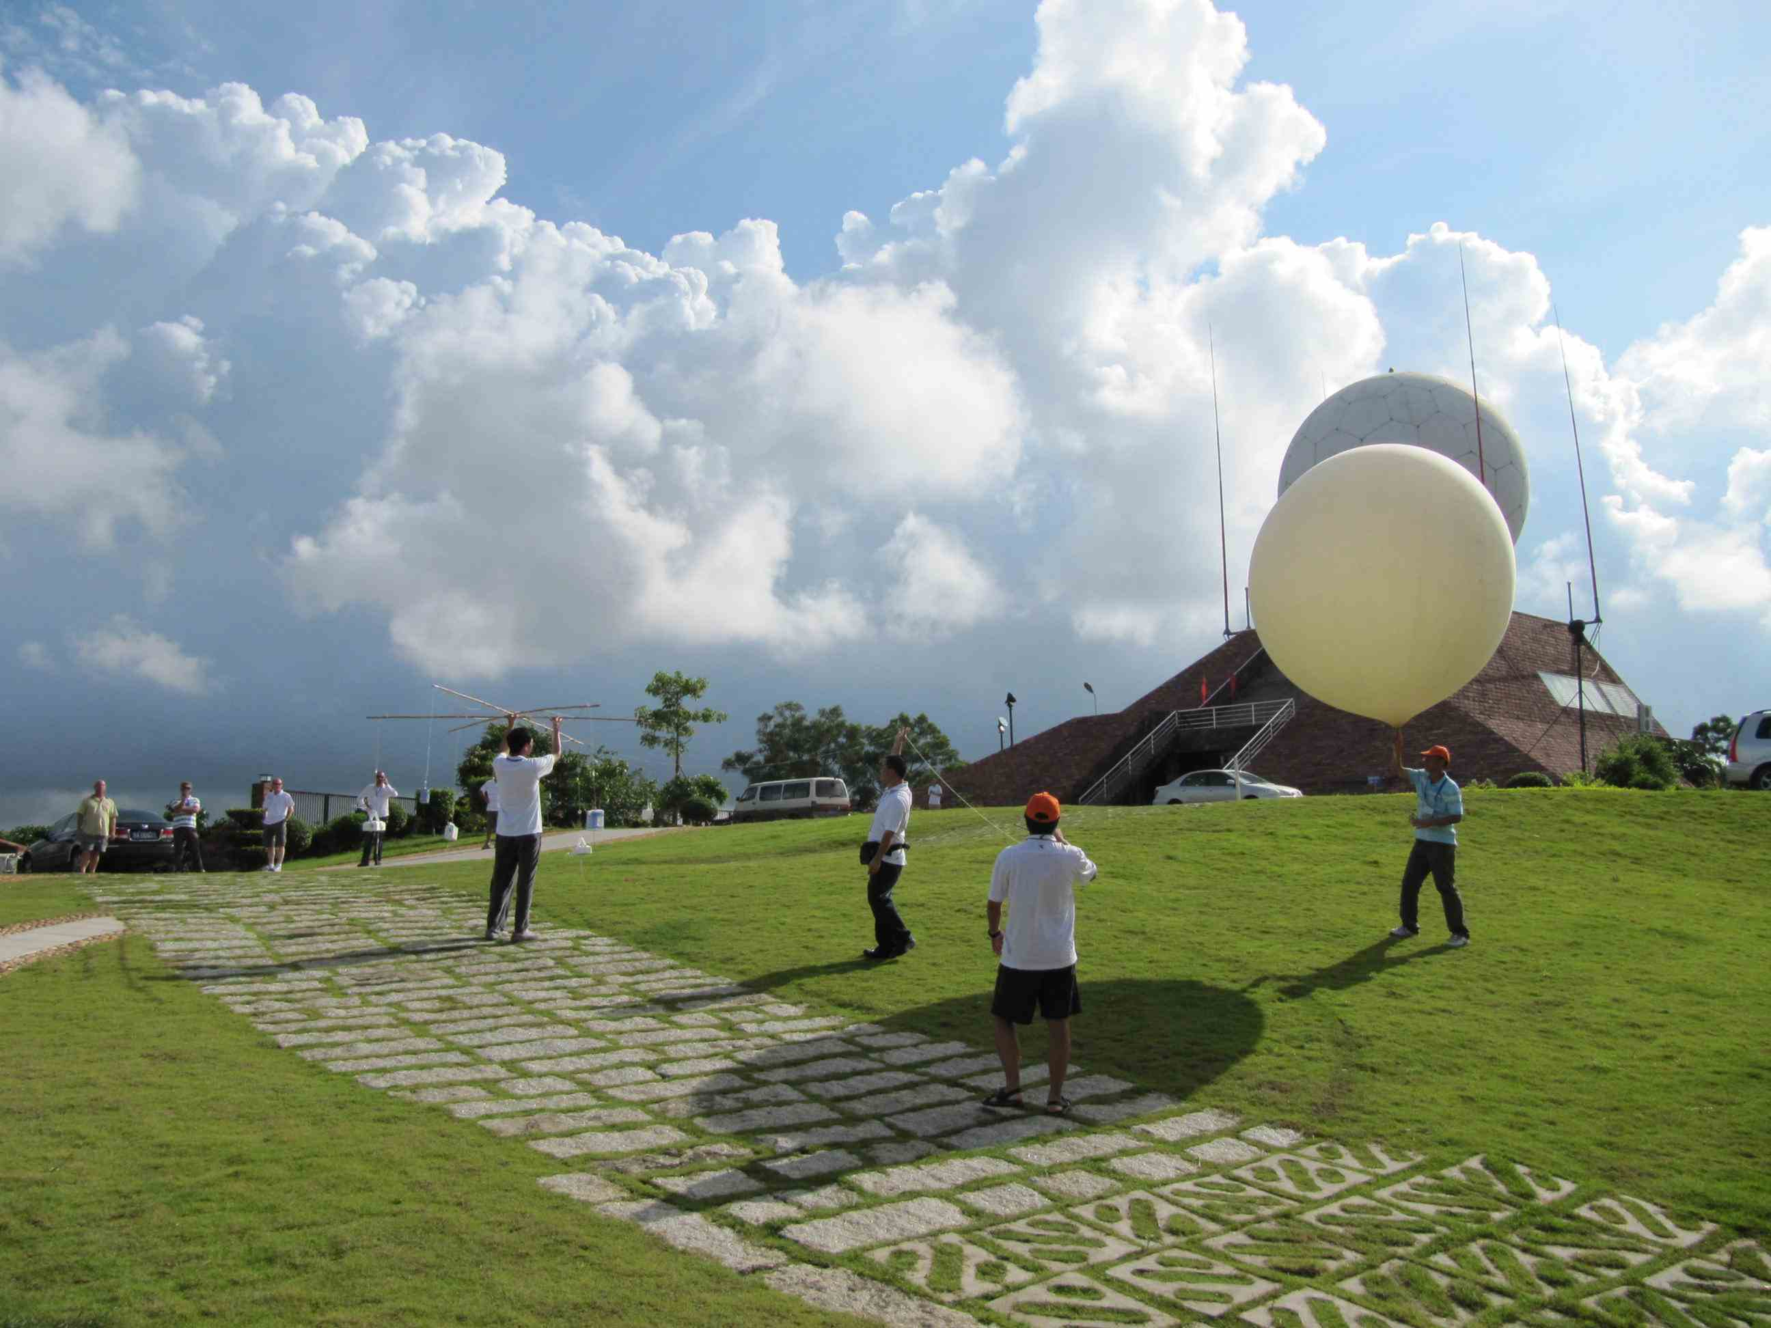
Notes:
39

Slide 40
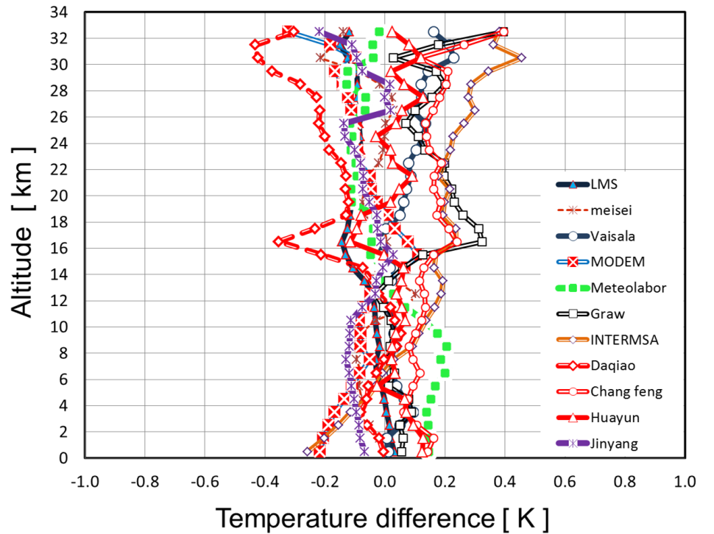
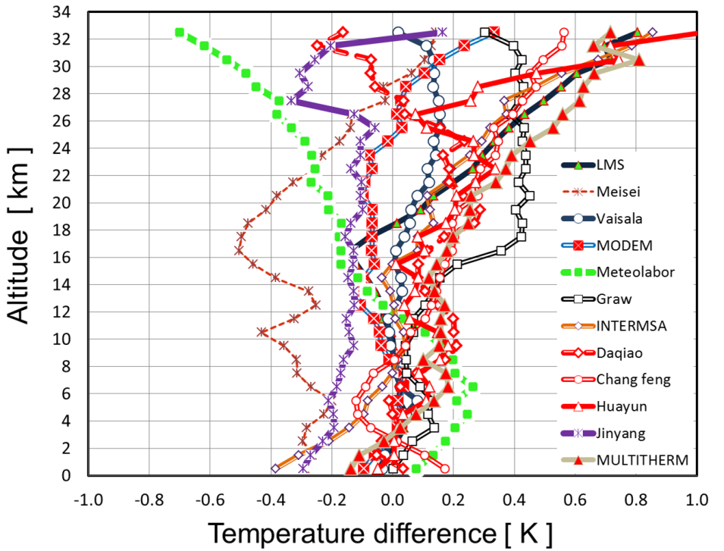
WMO Intercomparison of HQRS
Yangjiang, China, 12 July - 3 August 2010
Radiation Error on upper-air Temperature
Night
Day
J. Nash, T. Oakley, H. Vömel, LI Wei, WMO/TD-No. 1580, 2011

Slide 41
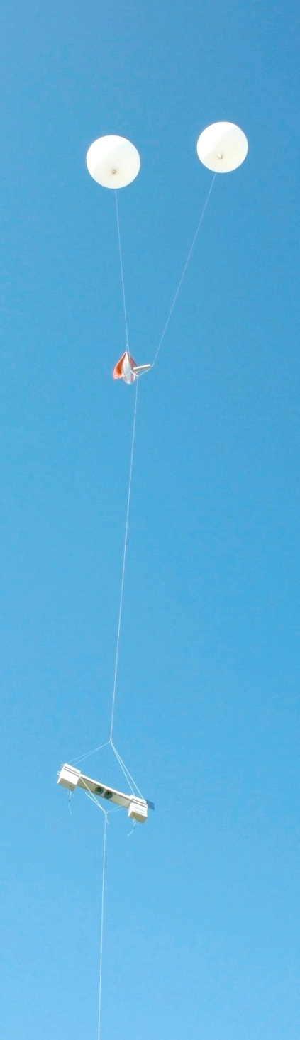
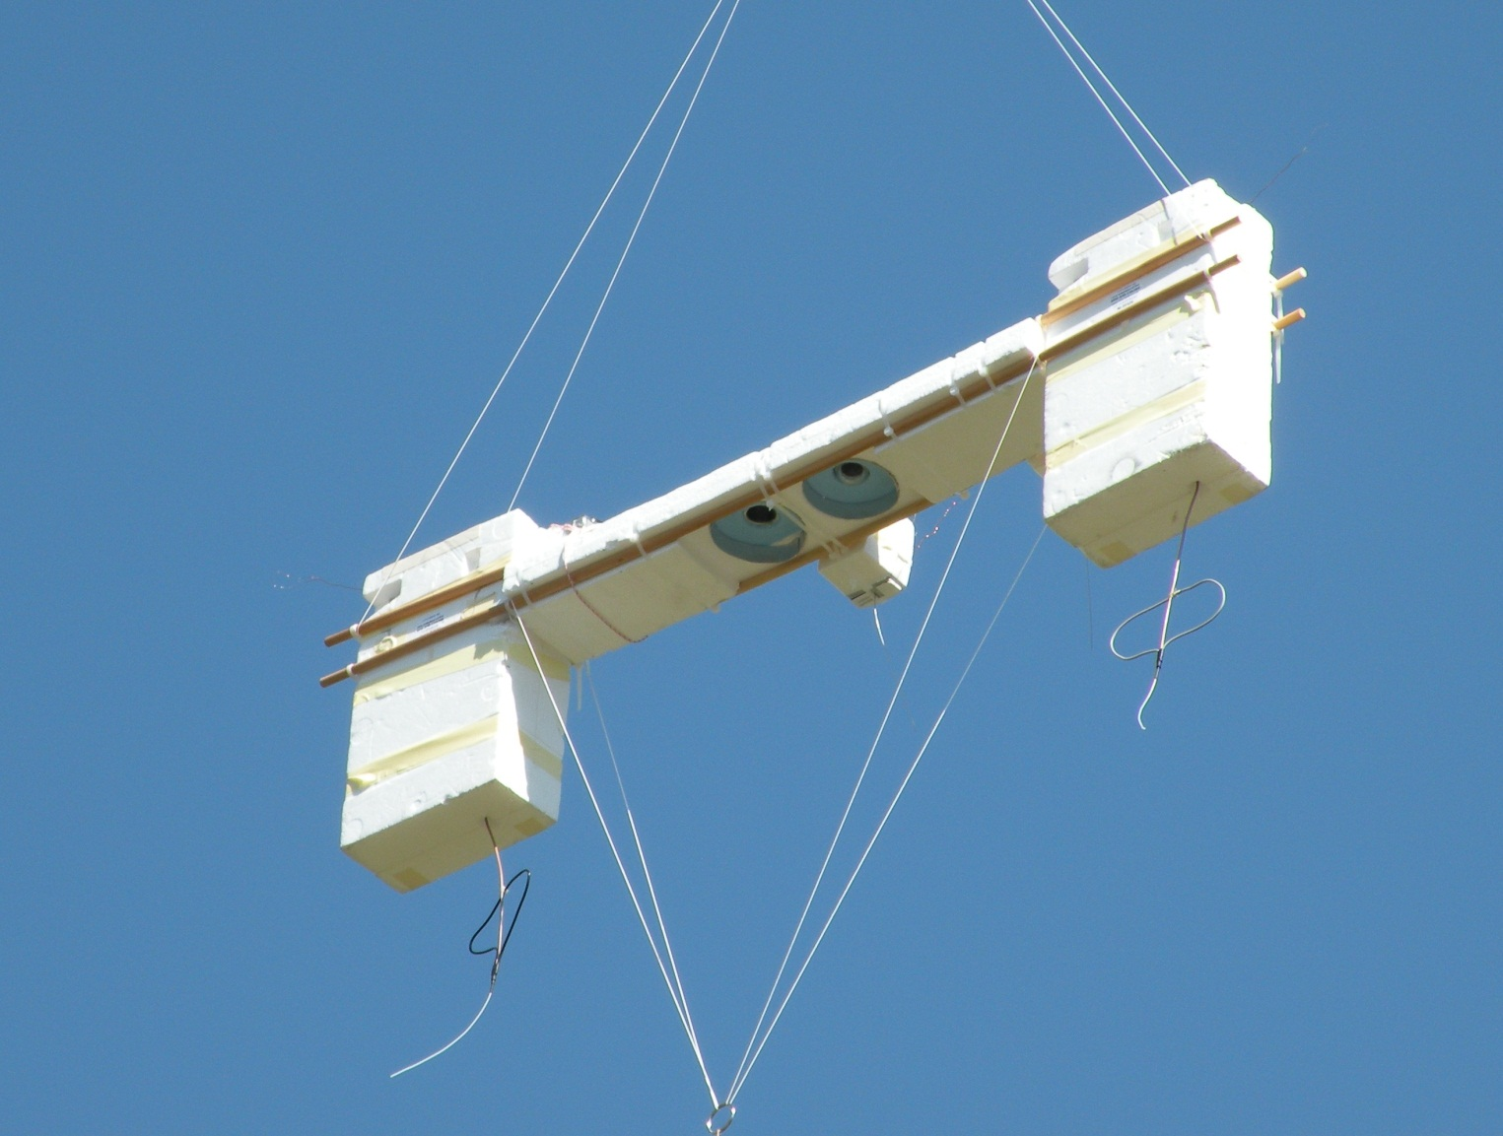
Federal Department of Home Affairs FDHA
Federal Office of Meteorology and Climatology MeteoSwiss

Slide 42
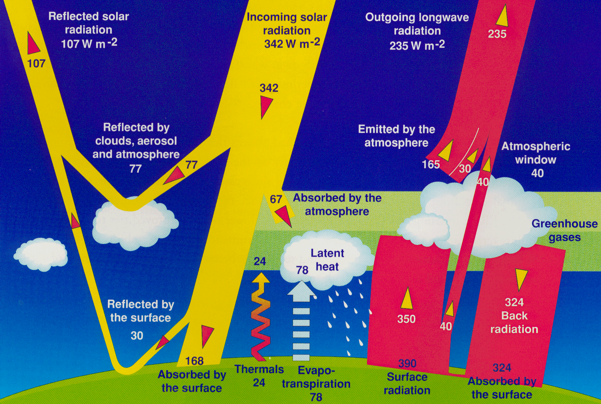
Solar and Thermal
Radiation Fluxes
Federal Department of Home Affairs FDHA
Federal Office of Meteorology and Climatology MeteoSwiss
Satellite Radiation Measurements
Solar shortwave Radiation
Thermal longwave Rad.
SUR
SDR
LUR
LDR
SUR
SDR
LUR
LDR
168
Kiehl and Trenberth
Kiehl and Trenberth
Surface Radiation Measurements

Slide 43
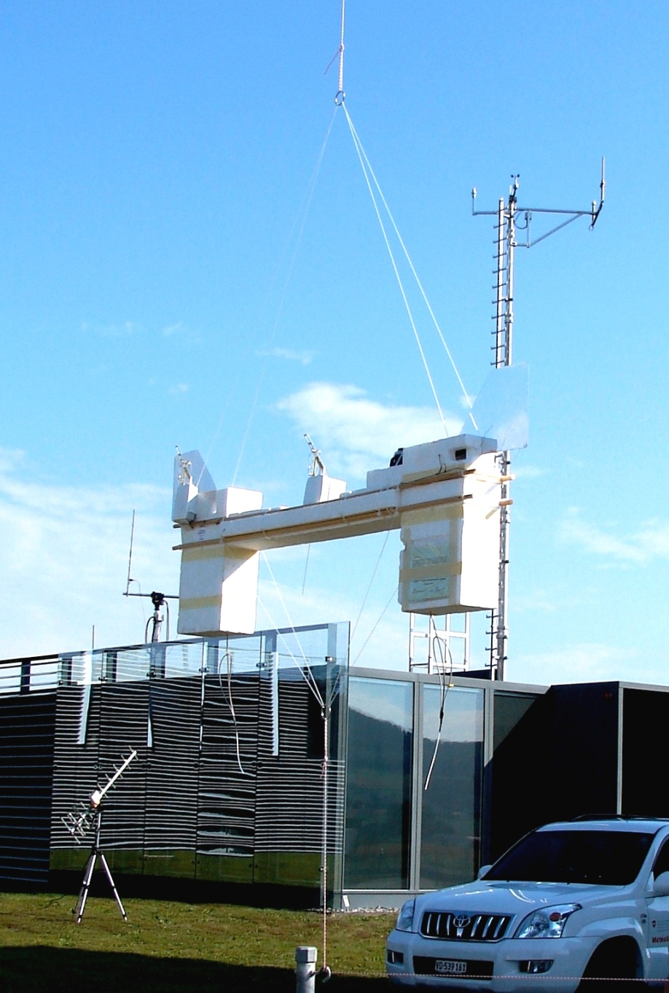
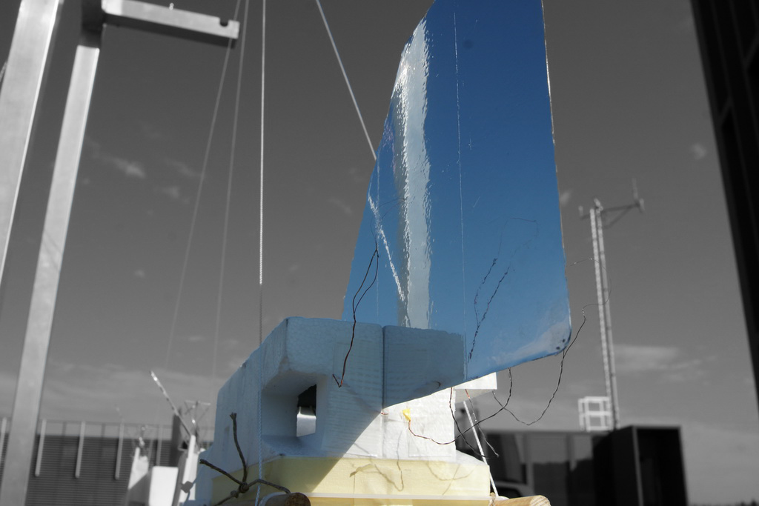
Measuring the Radiation Error in Flight
50 micron thermocouple
temperature sensors
unshaded and shaded

Slide 44
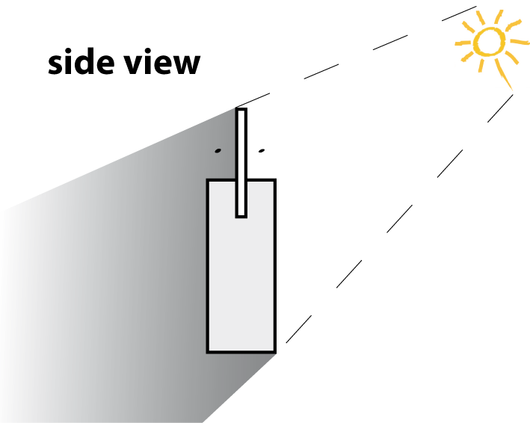
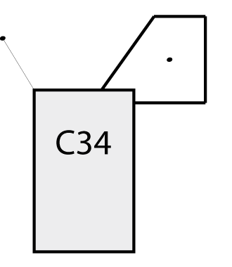
Shaded and unshaded Temperature in Flight
Aluminium plate (brilliant / black) attached to SRS-C34
Temperature sensors on both sides (5cm distance)
Alternately one sensor is exposed to the sun
front view
Reference
sensor
T sensor
SRS
C34

Slide 45
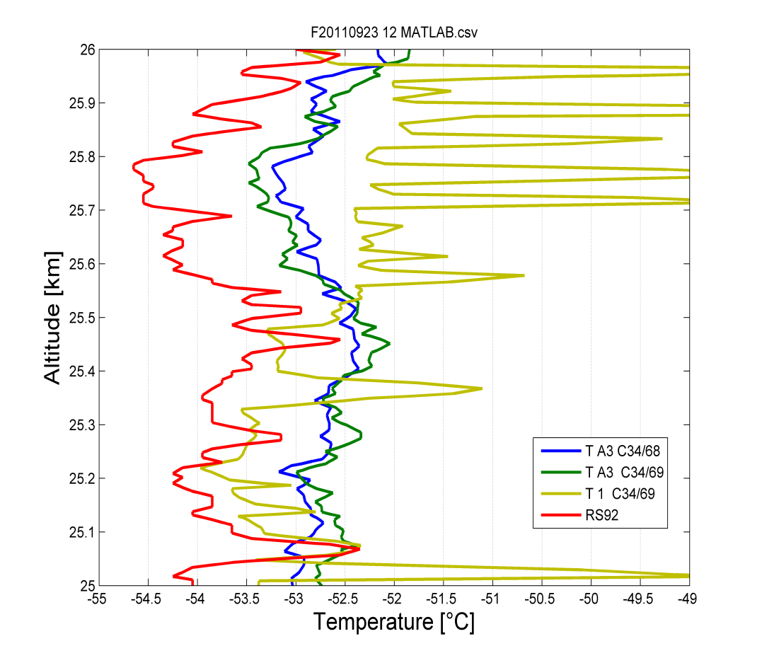

Radiation Error on Temperature

Slide 46






Radiation Error measured in Vacuum Chamber
Experiment with one Meteolabor sonde
having three thermocouple sensors
with wires of 20μ, 50μ and 100μ
1 Minute on, 1 Minute off
P = 5 hPa
v = 5 m/s
Observatory of Lindenberg Vacuum Chamber
Xenon Arc Lamp, Intensity: ~ 1650 Wm⁻²
P = 10 hPa
v = 5 m/s
P = 30 hPa
v = 5 m/s
P = 100 hPa
v = 5 m/s
P = 300 hPa
v = 5 m/s

Slide 47


Radiation Error: Atmosphere / Laboratory
Old correction
New correction
100μ Lab
50μ Lab
20μ Lab

Slide 48


Radiation Error Night and Day
Night
Day
Solar and thermal radiation errors on upper-air radiosonde temperature measurements
R. Philipona et al., Journal of Atmospheric and Oceanic Technology JAOTech 2013
Thermal and solar radiation errors on air temperature measured with upper-air radiosondes
R. Philipona et al., Journal of Geophysical Research, 2012

Slide 49

WMO CIMO:
3 decades of International Intercomparison

Slide 50

Feasibility of an Upper-Air Measurement intercomparison
«radiosonde and remote sensing
in constant evolutions»
GRUAN meeting Italy Feb. 2015
Traceability and uncertainties
Philipona, Kräuchi, Brocard, GRL, 2012 doi:10.1029/2012GL052087
GoPro avion 01.wmv

Slide 51

II. WMO Solid Precipitation InterComparison Experiment (SPICE)
20 sites - 15 countries
>20 instrument providers
Approx. 80 gauges under test
Tipping buckets
Weighing gauges
Non-catchment gauges
Field experiment just completed
Final report due 2016

Slide 52

WMO Solid Precipitation Intercomparison Experiment (SPICE)
Cg-17, Agenda Item 2.5

Slide 53

WMO Solid Precipitation Intercomparison Experiment (SPICE)
Cg-17, Agenda Item 2.5

Slide 54

WMO Solid Precipitation Intercomparison Experiment (SPICE)
Δ > 40% !!!
The World Meteorological Organization Solid Precipitation InterComparison Experiment (WMO-SPICE) and its applications
Editor(s): M. E. Earle, S. Morin, R. M. Rasmussen, M. A. Wolff, and D. Yang
In prep.: Special issue jointly organized between Atmospheric Measurement Techniques,
Earth System Science Data, Hydrology and Earth System Sciences, and The Cryosphere
http://www.earth-syst-sci-data.net/special_issue400_78.html
Cg-17, Agenda Item 2.5

Slide 55




Hail measurements

Slide 56



Global climatology 2002 - 2011
>2 cm

Slide 57

Global climatology 2002 - 2011
>3 cm

Slide 58

Global climatology 2002 - 2011
>4 cm

Slide 59

Global climatology 2002 - 2011
>5 cm

Slide 60
Hail in the Alps
>2 cm
Low radar visibility or lower severe thunderstorm frequency?

Slide 61



Rad4Alp_newsMay15_def.mp4
Remote sensing
+
In situ observation
+
crowdsourcing
Cg-17, Agenda Item 2.5

Slide 62



Slide 63




A network of Weather Radar
Xmas 2013 48hrs precipitation
26 January 2014 23 UTC
With Plaine Morte
Gstaad
Leuk
Yverdon
Measurements from Plaine Morte
?
blue >5mm
yellow >50mm
Without Plaine Morte
Aigle
Sion
Léman
Measurements from La Dole

Slide 64

A Multi-sensor integration
Radar-only
Radar + raingauge
1-hour sum
Color inside circles indicates precipitation collected by raingauge.
Comparison of the 2 figures nicely shows benefit of combination.

Slide 65


With emerging other technologies
Vaisala Price, CIMO St Petersburg 2014

Slide 66

8.30pm
+15’
10.30pm
+15’
RADIO
LINK
RADAR
+RAIN GAUGES

Slide 67

MobiliarLab Hagelfilm v06 DE 1080p.mp4
Bertrand Calpini
WMO CIMO
Weather radars – ISO standard versus WMO recommendations - the WMO-CIMO point of view
Urs Germann CH, Paul Joe Canada, Daniel Michelson Sweden

Slide 69

Rolling Review of Requirements
State what you (or someone else) need(s)
Assess what you (or someone else) have/has
Compare requirements and capabilities
Draw conclusions
Repeat & improve
Analysis
«Critical Review»
Improved services for society
Guidance for Action
Surface-based observing systems
RRR
Capabilities
Requirements
Space-based observing systems
Notes:
Recently discovered a thorough analysis of Vol A, by

Slide 70

https://oscar.meteoswiss.ch/OSCAR/

