Slide 1
GNSS – Global Navigation Satellite Systems
Cours de formation continue
CRP - Commission Romande de Physique Champéry
22 septembre 2017
EPFL IMT-NE ESPLAB
IMT - Institut de microtechnique
Pierre-André Farine

Slide 2
GNSS – Global Navigation Satellite Systems
CRP Champéry 22 septembre 2017
History, terrestrial and satellite radionavigation
GPS - Principles, signal detection in noise
Accuracy and positioning errors
High sensitivity, GPS indoor
GNSS: Glonass, Galileo, Beidou and others
Interoperability between systems
Conclusions

Slide 3
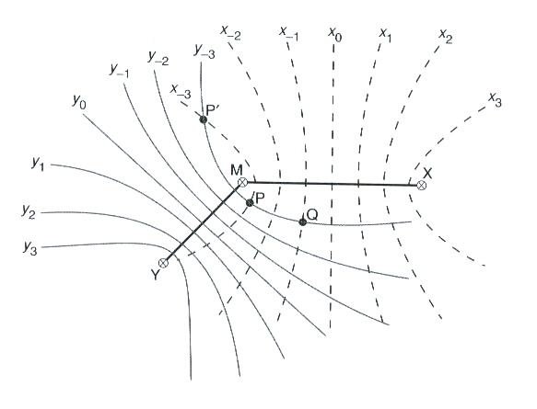
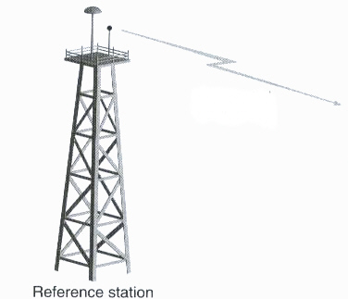
Historical review - Terrestrial systems
TDOA Hyperbolic positioning - Time Difference of Arrival from several separated transmitting stations
Decca : 70-126 kHz, CW, since 1944
Loran C : 100kHz pulses, distance
between transmitters 1000 km,
precision 250m
Omega : 10.2-13.6 kHz, transmitters
distance 10’000 km, precision 2-4 km
VOR (VHF Omni-directional Radio
range)/DME : 110 MHz, 30t/s
(precision 2.7°), 1000 MHz beacons,
+/-60MHz, precision 400m

Slide 4
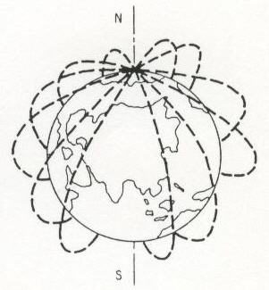
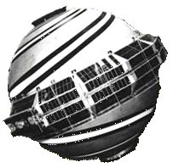
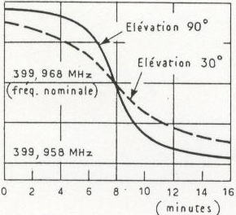
Satellite Systems : NNSS (Navy Navigation Satellite System) Transit
Doppler positioning
US Navy 1964, civilian 1967
Satellites (8), altitude 1000 km
Polar orbits 100 min.
Emitters 150 et 400 MHz
Use of Doppler effect
Timing and orbital data
Precision : +/- 200 m
Advantages : Lat./Lon./Time,
Worldwide coverage
Drawback: 15 min. needed,
intermittent, inaccurate

Slide 5
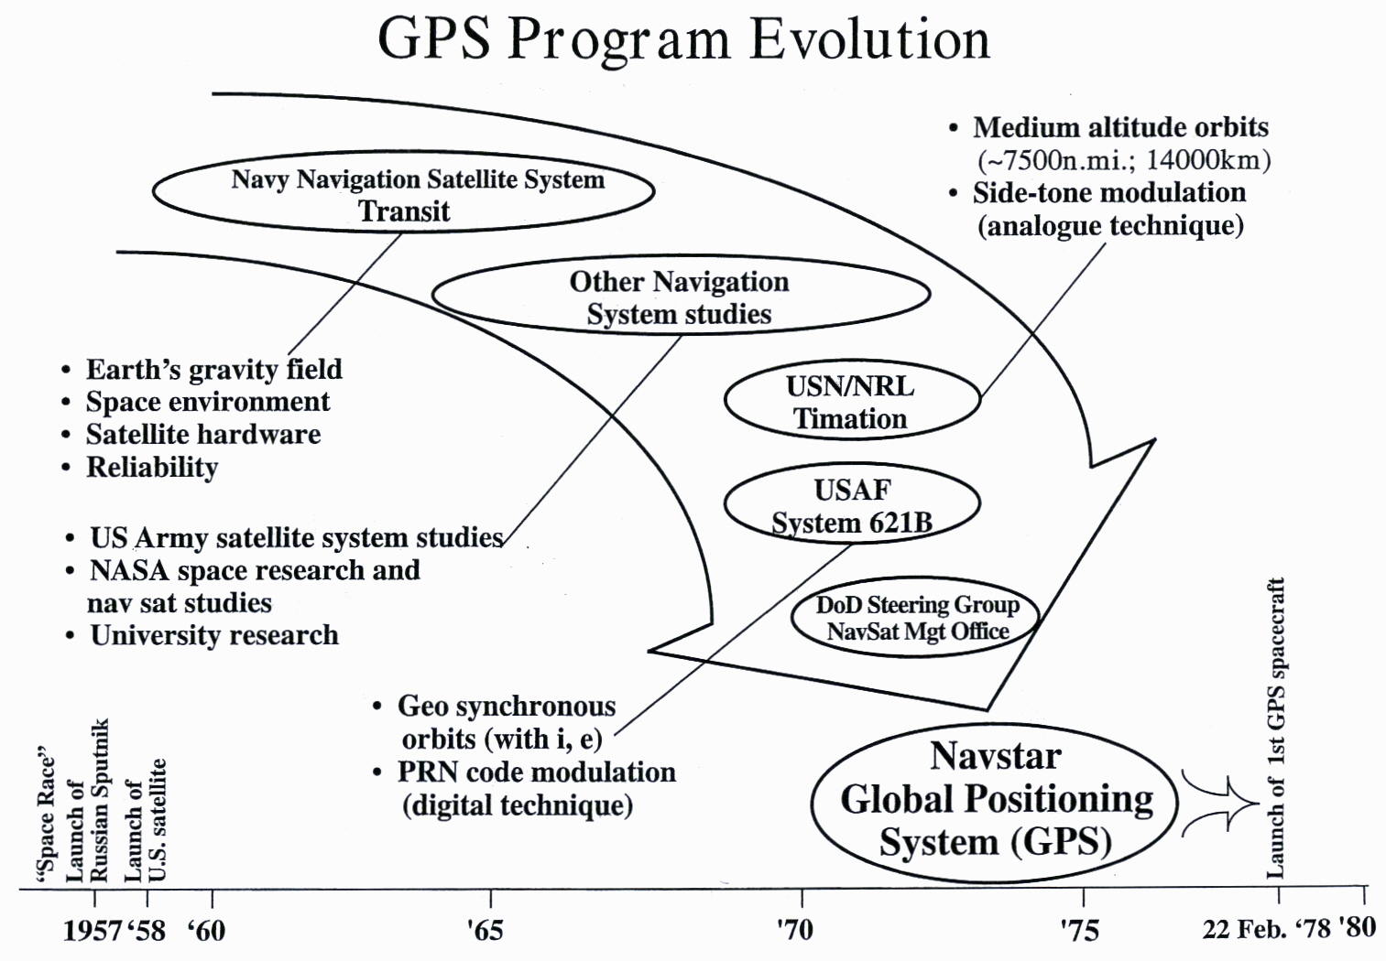
GPS Program Evolution

Slide 6
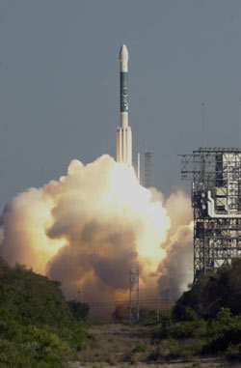
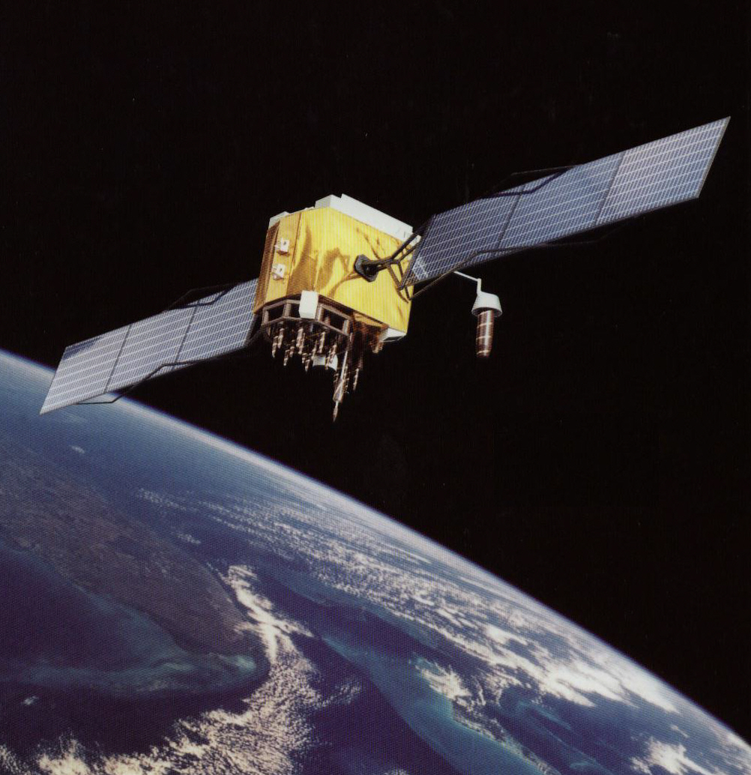
NAVSTAR - GPS : NAVigation System Timing And Ranging - Global Positioning System
Notes:
RADAR : RAdio Detection And Ranging - NAVSTAR: NAVigation System for Timing and Ranging – GPS Global Positioning System

Slide 7
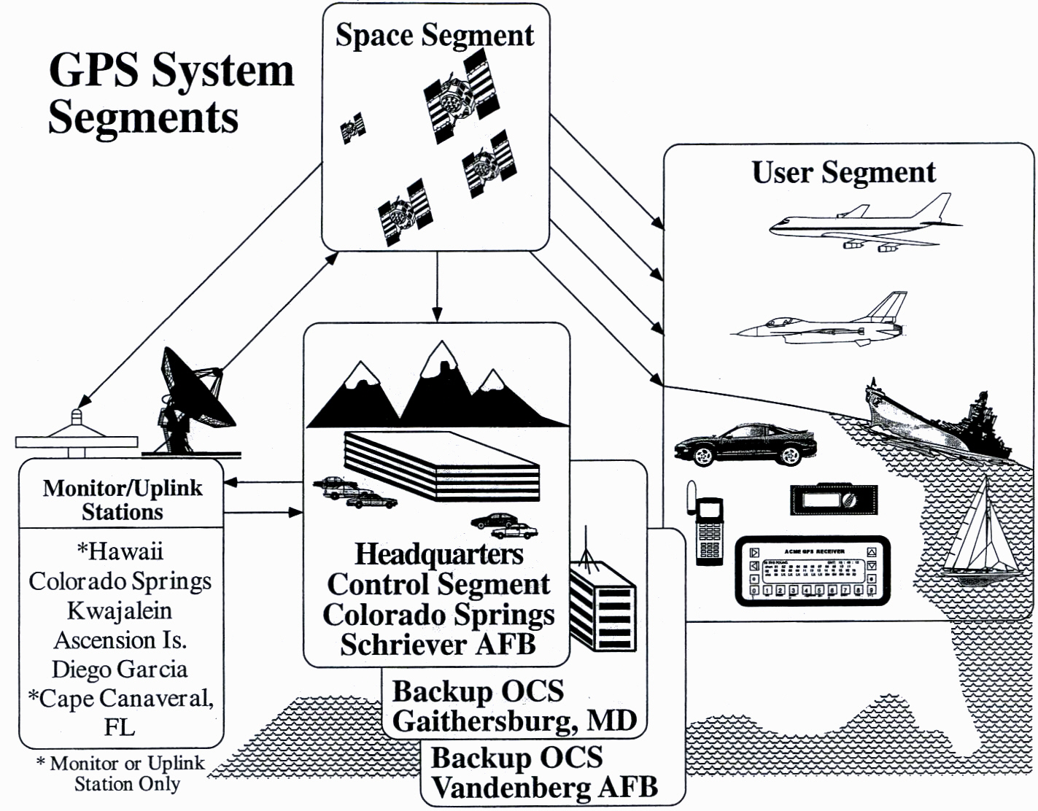
GPS – Les segments du système

Slide 8
NAVSTAR - GPS : NAVigation System Timing And Ranging - Global Positioning System
Space Segment (emitters):
24 satellites located in
6 orbital planes at
20’178 km altitude &
55° inclination,
Each satellite transmits at
1.57542 GHz (L1 band) &
1.22760 GHz (L2 band)
User Segment (receivers):
TOA – Time of Arrival et Code/ Phase of at least 4 satellites in order to estimate
Position (X, Y, Z)
Velocity (v_{x}, v_{y}, v_{z})
Time (T)
“PVT solution”

Slide 9
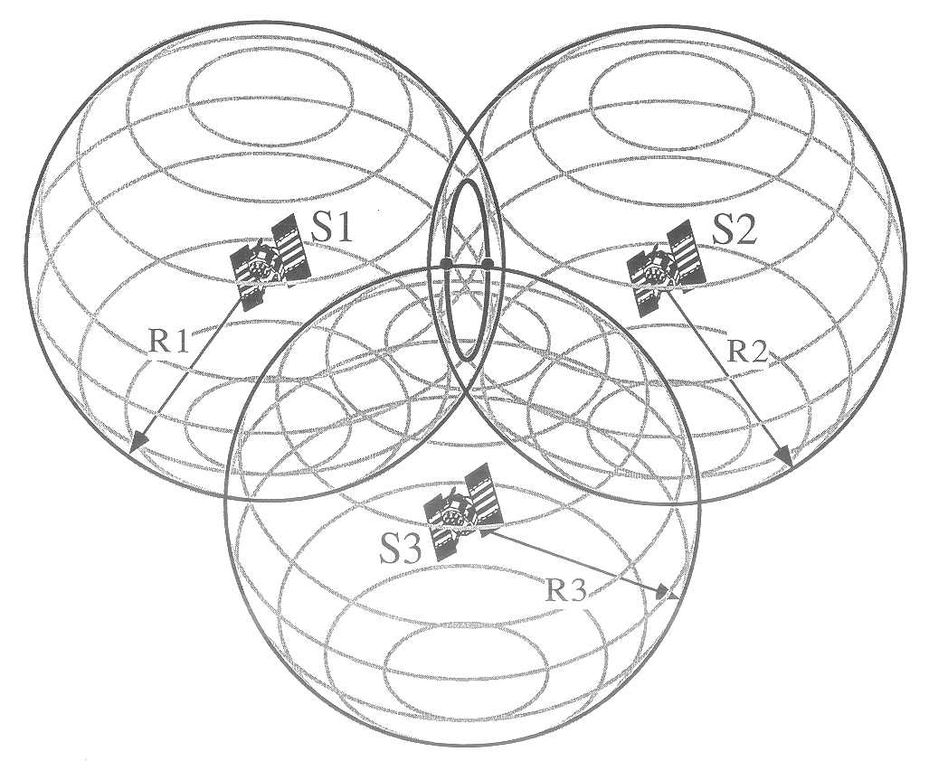
Principle of Global Positioning System
TOA positioning by
trilateration
Passive System
VHF Emission in
L1 Band
Measurement of
propagation time
ΔT_{i} :
R_{i} = c ·ΔT_{i}
R_{i} = range of SV i
ΔT_{i} = elapsed time between SV_{i} and user/receiver
L1 : 1.57542 GHz
λ = 19 cm
L2 : 1.22760 GHz
λ = 24.4 cm
SPS
PPS

Slide 10
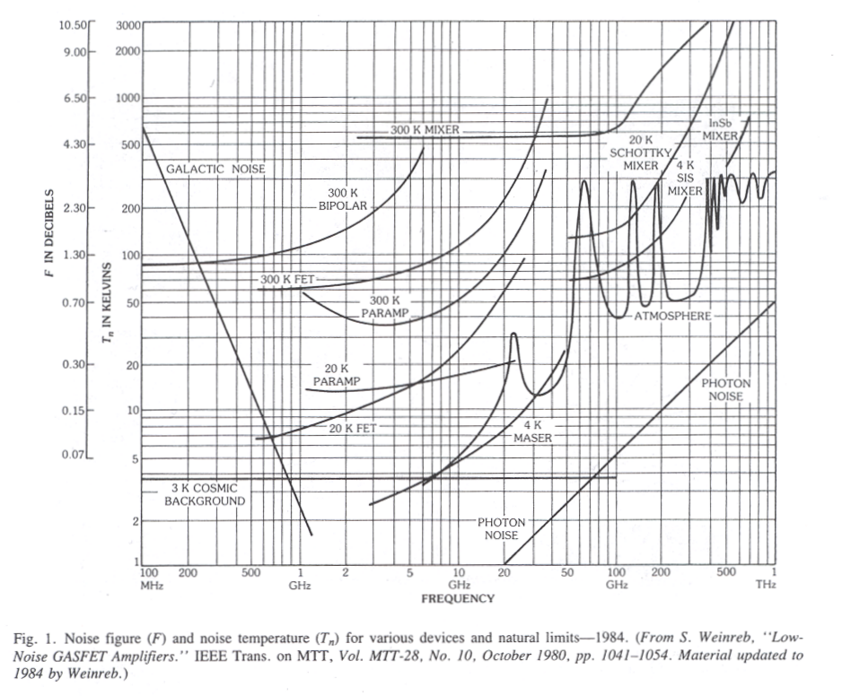
Noise Temperature T_{n} with frequency in space and around the Earth
E5, L5, G2, L2
L1, E1, G1

Slide 11
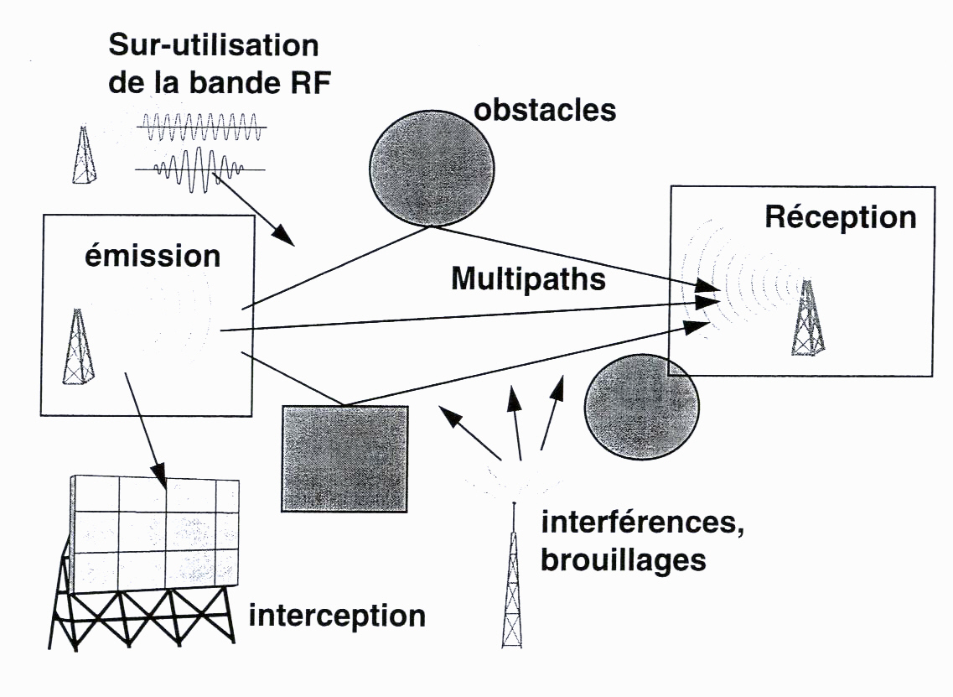
Requirements for the GPS signals
Multiple use of
RF band
Range estimation
Receiver
Transmitter
Precision (< 10m)
Multiple access
Interf. protection
Multipaths
Clouds, rain, etc.
Ionosphere, tropo.
interferences,
jamming

Slide 12
Multi-user, multiple access communications
FDMA : Frequency Division Multiple Access
TDMA : Time Division Multiple Access
CDMA : Code Division Multiple Access
FDMA
TDMA
CDMA
Band 3 – user 3
Separation of
Users 1,2,3
by orthogonal
codes
frequency
Band 2 - user 2
frequency
frequency
Time slot 1
user 1
Time slot 2
user 2
Time slot 3
user 3
Band 1 – user 1
time
time
time

Slide 13
Spread Spectrum Modulation
Classical Modulation :
data x(t)
Spread Spectrum « layer » :
Additional Pseudorandom
Noise PN Modulation
THSS
FHSS
DSSS
ASK
FSK
PSK
carrier c(t) = A_{p}.cos(ω_{p} t + φ_{p})

Slide 14
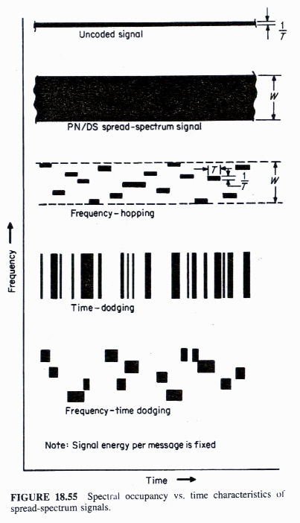
DSSS, FHSS, THSS Spread Spectrum
Original signal x(t), uncoded, bandwidth B
B
W
DSSS, Direct Sequence Spread Spectrum, signal x(t) with PN sequence, bandwidth W
B
W
FHSS, Frequency Hopping Spread Spectrum, frequency changing with PN sequence
frequency
THSS, Time Hopping Spread Spectrum, time changing with PN sequence
Combination of FH-TH SS, double change in frequenvy and time
Note: Signal energy per message is fixed
time

Slide 15
Requirements for GPS signals

Slide 16
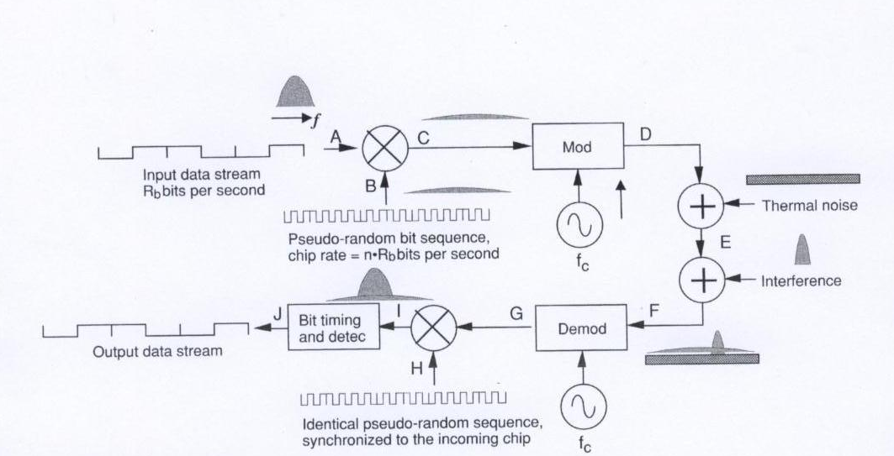
CDMA system -
Interference suppressed at the receiver

Slide 17
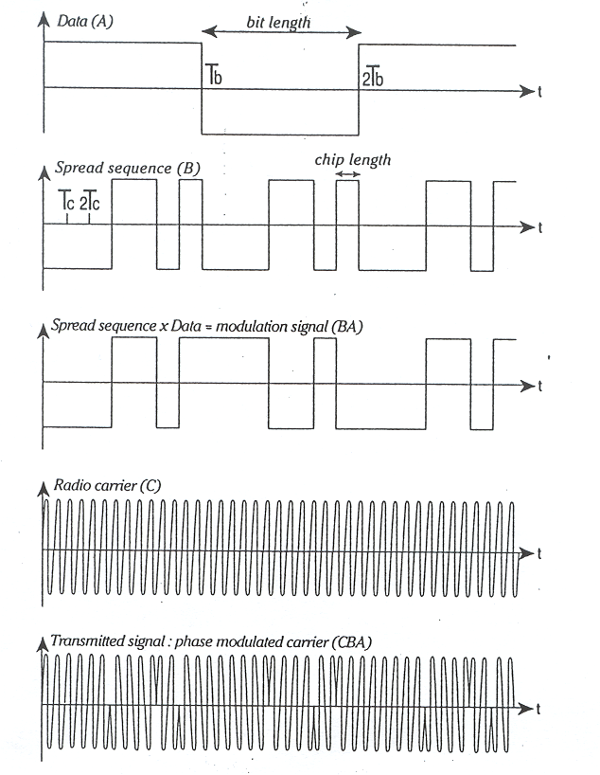
CDMA – Data, code, carrier
Data d(t)
PN Sequence C_{CA}(t)
C_{CA}(t)⊕d(t)
Carrier c(t)
Modulated Carrier

Slide 18
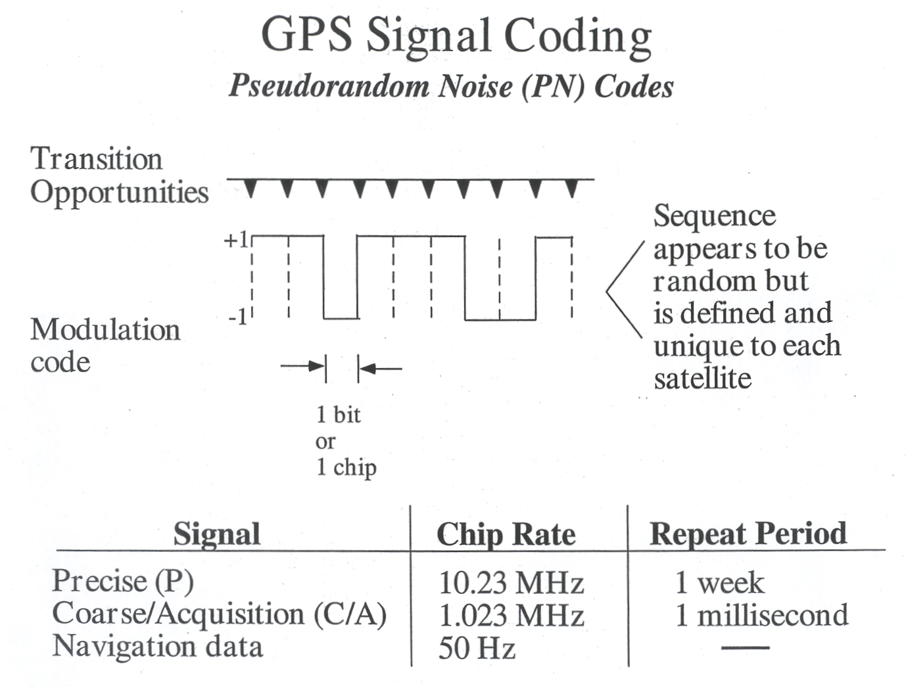
GPS - Pseudorandom Noise PN Codes

Slide 19
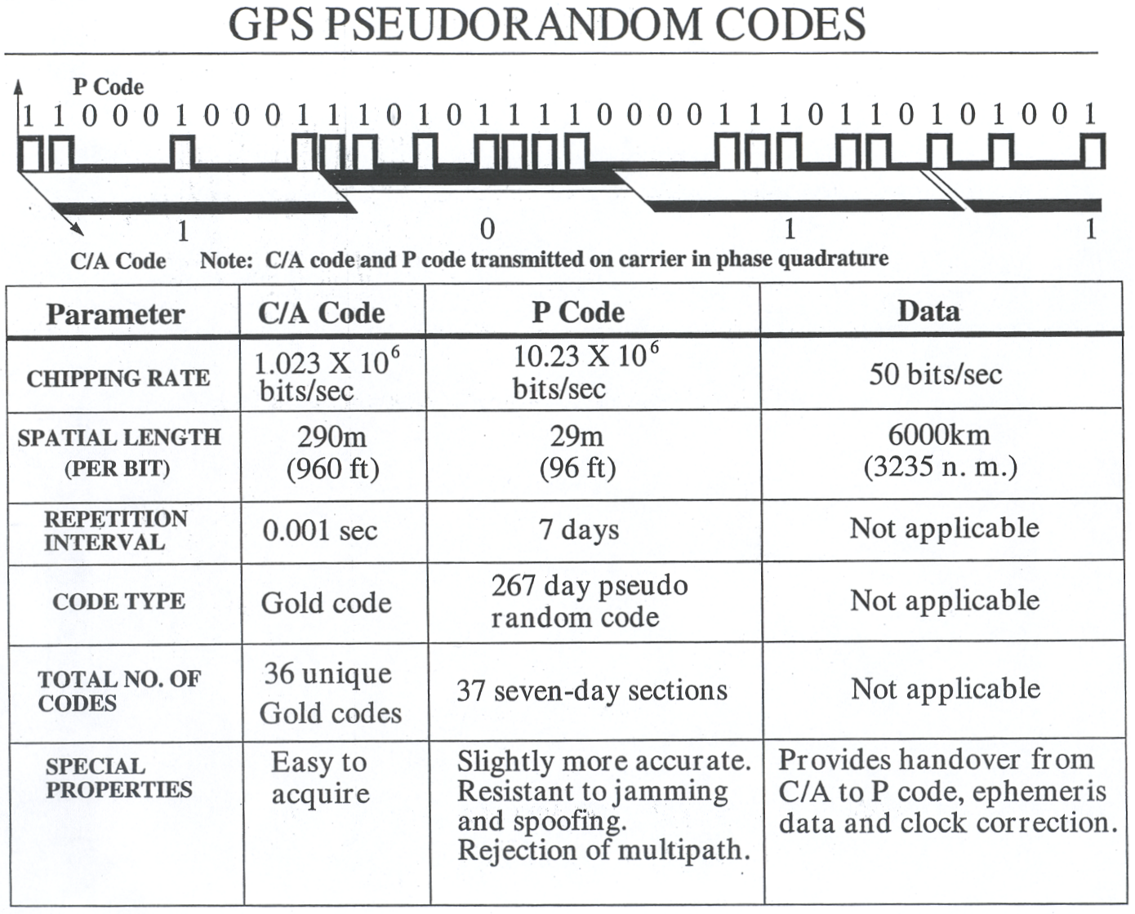
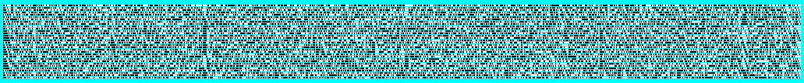
Pseudorandom PN codes for GPS

Slide 20
GPS L1 – PN Transitions
154 carrier cycles per P-code chip

Slide 21
GPS Signals Modulation Techniques
(7 jours)

Slide 22
Rectangular Pulse, Fourier Transform, Power Spectral Density, Crosscorrelation
Wiener Theorem

Slide 23
GPS – C/A et P (Y) PSD

Slide 24
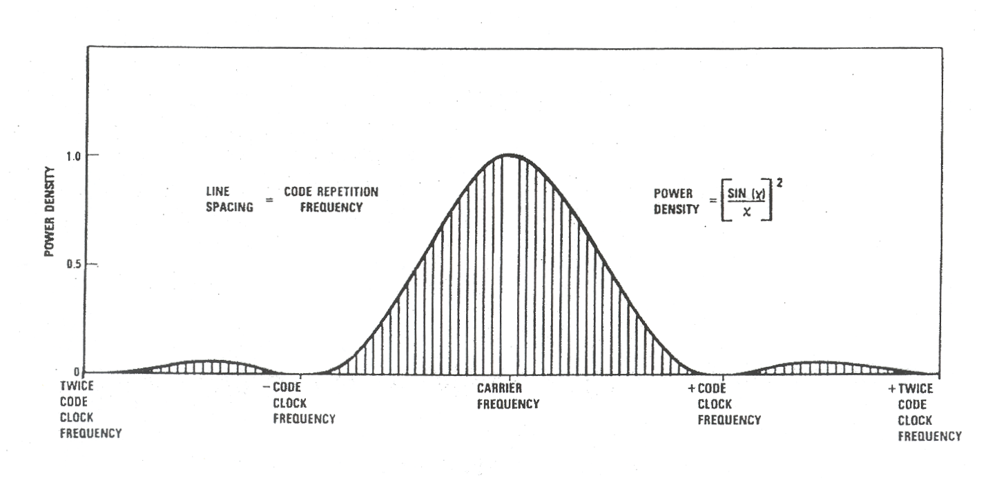
PSD – Power Spectral Density
Carrier modulated with a PN code
1 kHz
-1.023 MHz
+1.023 MHz
L1: 1.57542 GHz
L2: 1.22760 GHz

Slide 25
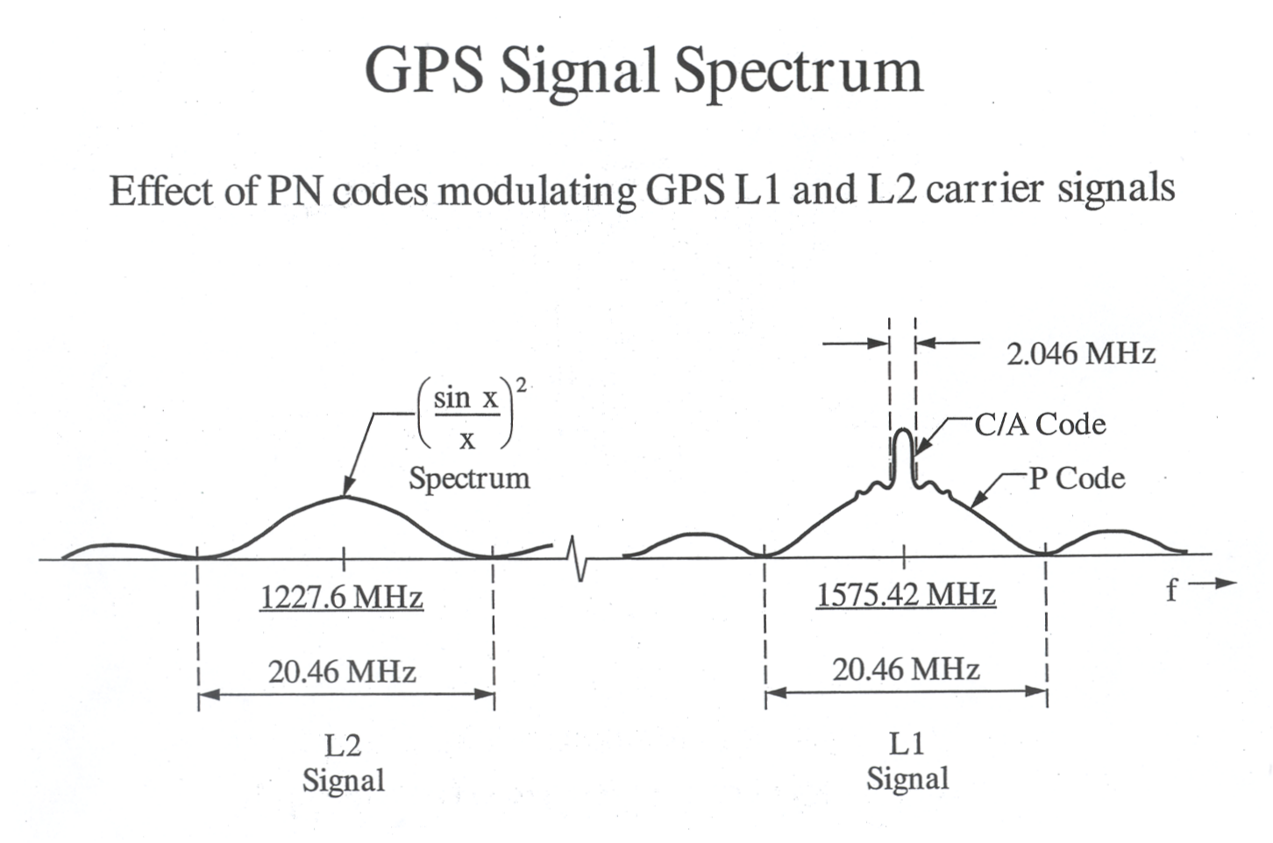
Spectrum for GPS signals
Effects of the PN pseudorandom codes C/A et P
modulating L1 and L2 carriers

Slide 26
Signal Power at the receiver
Power Loss in Space :
(R_{su} = 25’785 km
λ = 0.19 m)
Signal Power at the receiver (5° elevation) :
P_{r} = 24.6 dBW - 184.6 dB = -160 dBW
Receiver noise C/N₀ (carrier / noise density ratio) :
C/N₀ = P_{r} + G_{a} - (k·T₀ + NF) with : G_{a} = Antenna Gain
NF = Receiver noise figure
Example : C/N₀ = -160dBW - (-204dBW/Hz) = 44dBHz

Slide 27
Receiver Thermal Noise k·T₀

Slide 28
Power Spectral Density PSD [dBW/Hz]
Power spectral density

Slide 29
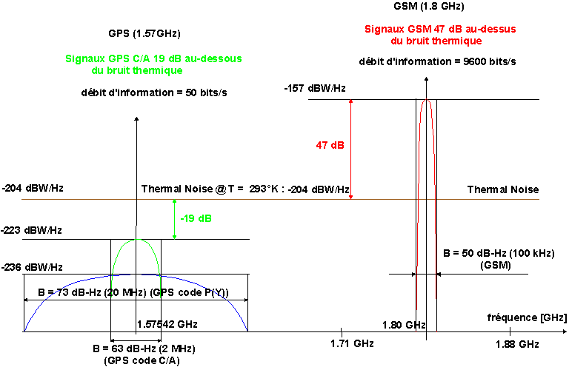
Comparison of the PSD for GPS and GSM signals

Slide 30
C/A Code Crosscorrelation

Slide 31
GPS Signal Detection by correlation
Correlation of the signal x(t) with the replica in the receiver :

Slide 32
Gain process G = 63 – 20 = 43 dB
Power spectral density

Slide 33
Acquisition – Code/Phase & Frequency Search

Slide 34
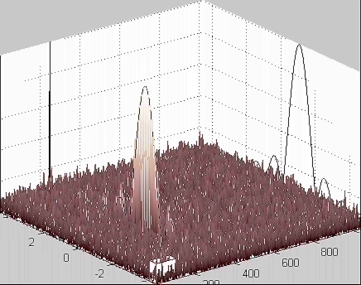
Acquisition – Code/Phase & Frequency Search
The GPS receiver to search during 1 ms the signal in each bin « code-phase & frequency ».
Approx. 1 second is needed to search all the possible codes in 1024 bins (one frequency).
Approx. 40 seconds are needed to look all the possible code in all the frequencies.
Code/phase
Frequency
Dr. F. van Diggelen

Slide 35
Tracking of the GPS signal
Satellite Signal
Early Local Replica RE
Late Local Replica RL
Early Correlation E
Late Correlation L
Tracking Function E-L

Slide 36
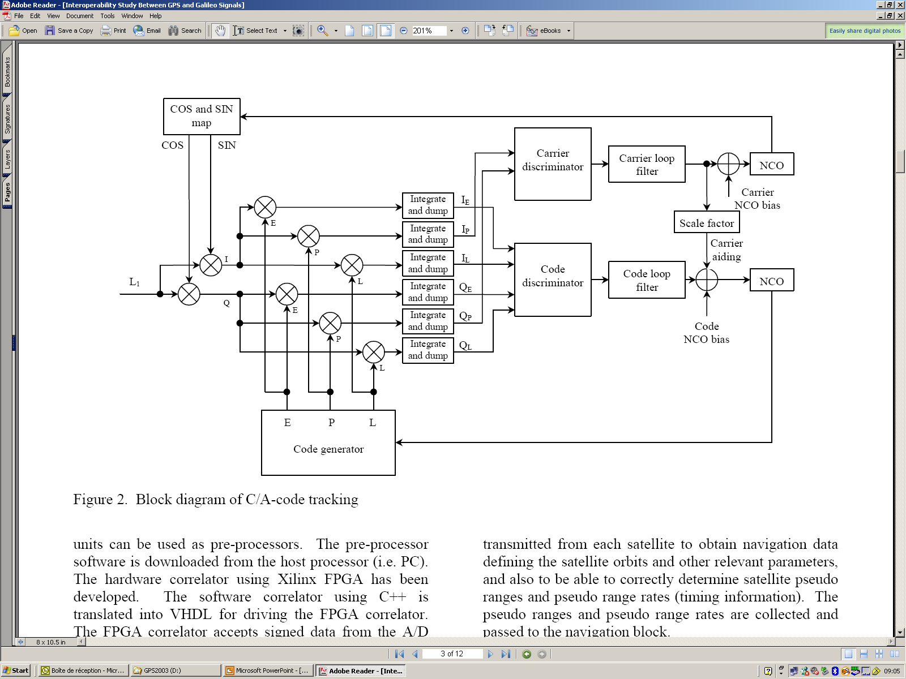
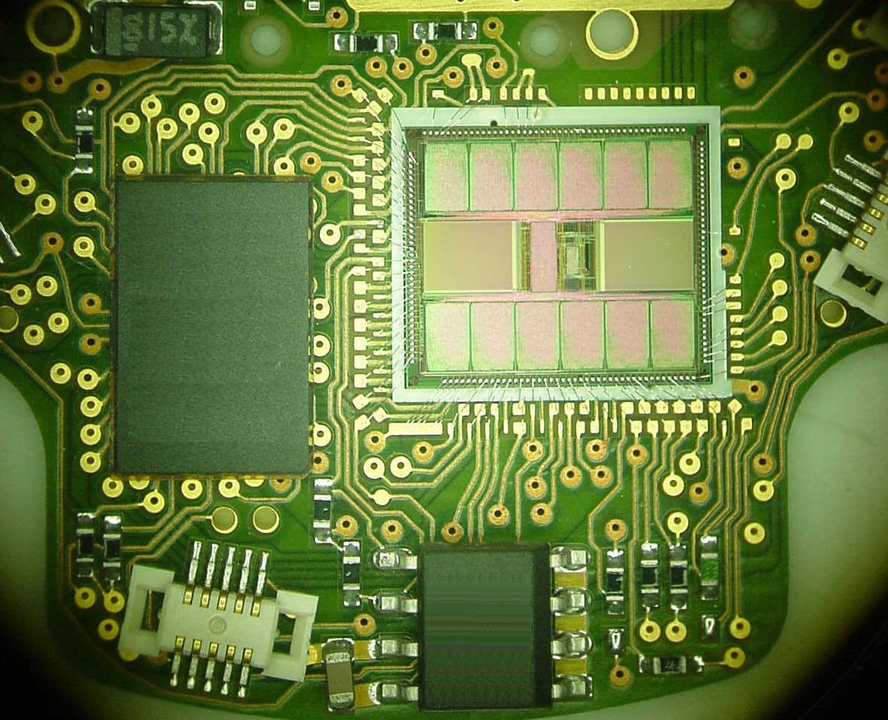
Correlator Schematic Diagram

Slide 37
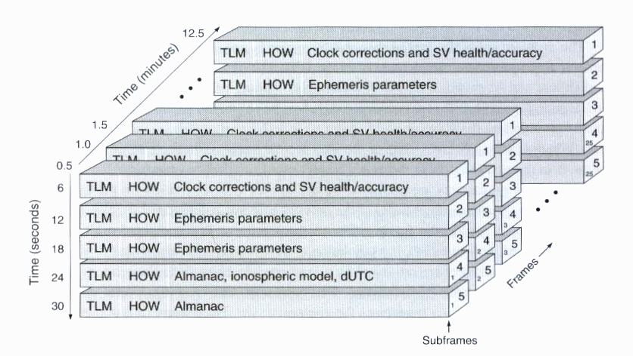
GPS L1 C/A Navigation Message

Slide 38
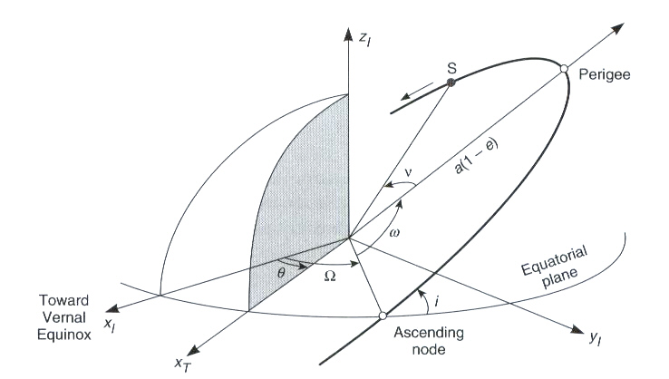
SV Ephemeris Parameters
GPS - Elliptical orbits characterization and SV positioning with Kepler’s Laws :
a : ellipse principal half-axis
e : ellipse eccentricity
i : inclination
Ω : ascending node
ω : perigee argument
: true anomaly
t_{OE} : ephemeris reference time
C_{i} : corrections

Slide 39
Détermination de la solution de navigation
vraie distance
pseudo-distance
Calcul des coordonnées de la position
(4 équations à 4 inconnues) :
(éphémérides)
Utilisateur
Résolution des coordonnées de position de l’utilisateur
Mesures de 4 valeurs de
(X_{u}, Y_{u}, Z_{u}) et de l’erreur d’horloge (ΔT_{B})
pseudo-distances
~
~
Erreur de distance du biais d’horloges = c ΔT_{B}
ΔT_{B} = biais des horloges utilisateur et satellite
ou erreur de temps
c = vitesse de la lumière
~
~
~
~
~
~
temps
Signaux transmis par
les satellites
~
Les mesures de ΔT_{n} comprennent l’erreur temporelle d’horloge (ΔT_{B})

Slide 40
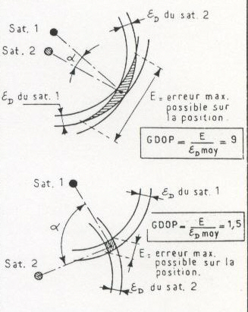
Précision et erreurs sur la position UERE et GDOP
UERE (User Equivalent Range Error)
Erreurs de mesure des pseudo-distances R_{j} :
- retards ionosphère et troposphère
- biais d’horloges - SA
- éphémérides - effets relativistes
- multi-trajets - bruit du récepteur
GDOP (Geometric Dilution of Precision)
Erreurs géométriques liées à la position
relative des satellites (HDOP, …, TDOP)
n > 4 satellites en vue, système
d’équations surdéterminé, résolution
par la méthode des moindres carrés.
un nombre élevé de satellites en vue
pour calculer la solution de navigation
améliore la précision, GNSS : GPS +
+ Glonass + Galileo + Compass + …
~
R₁
ΔR₁
R_{i}

Slide 41
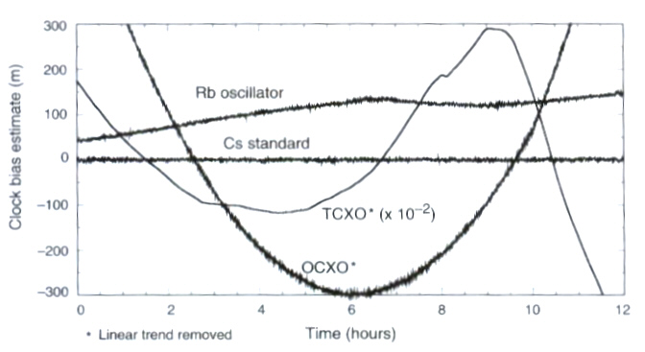
Stabilité de différentes horloges atomiques

Slide 42
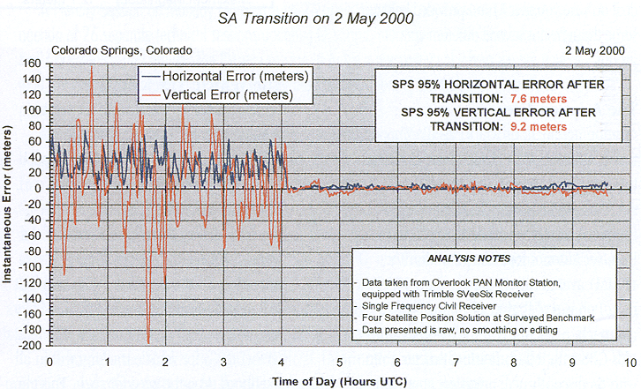
GPS – SA Selective Availability Interruption

Slide 43
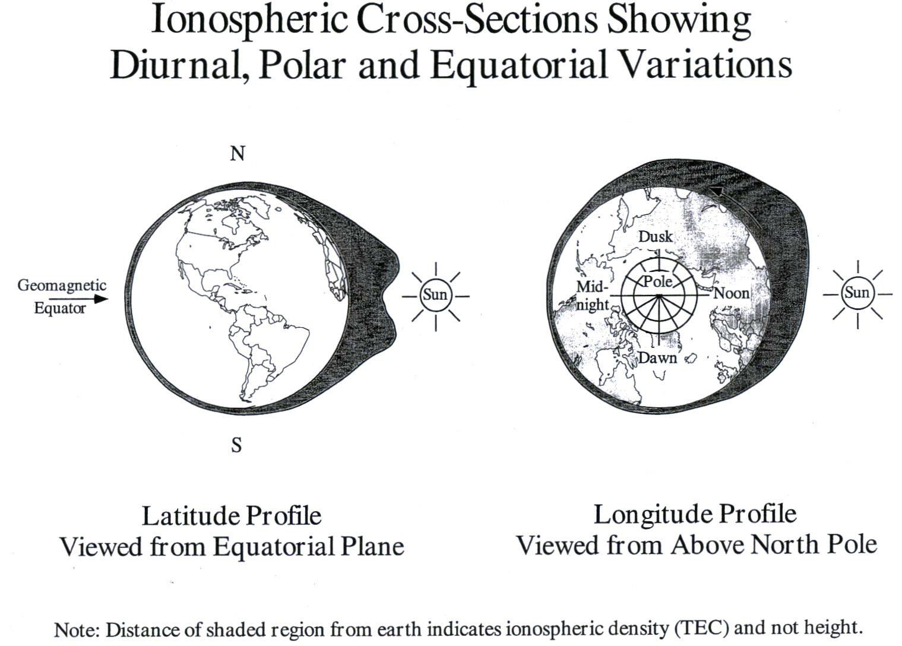
Effets de la ionosphère
ΔT_{Delay} = k / f ²

Slide 44
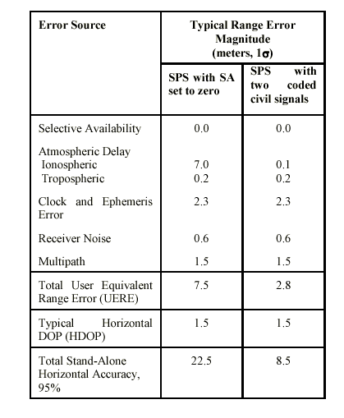
GPS – Standard Positioning System with 2 Civilian frequencies L1 and L2C
7.0
0.1

Slide 45
Digital Signal Processing Schematic Diagram
Correlation unit I & Q with n channels
DSP controller for each channel
Navigation unit with a separate microcontroller

Slide 46
Correlators – Carrier and Code Loops

Slide 47
Modernisation des signaux GNSS et amélioration de la sensibilité
Code L2CS sur GPS L2 (1.2276GHz) :
- Calibration des effets de la ionosphère avec 2 fréquences
L1/L2 (Erreur 1σ de 22m à seulement 8.5m)
- Redondance des signaux primaires C/A déjà sur L1
Code M sur GPS L1 (1.57542 GHz) et sur la bande GPS L2 :
- Nouveau signal militaire encrypté
- Indépendance avec le code C/A
Nouveau code sur GPS et Galileo L5/E5 (1.17645 GHz) :
- Correction du retard dû à la ionosphère
- Intégrité et protection contre les interférences
- Mesures de la phase de la porteuse et résolution de
l’ambiguïté en temps réel, mesures centimétriques
- Meilleures performances concernant le multi-trajet

Slide 48
BOC(fs, fc) - Binary Offset Carrier

Slide 49
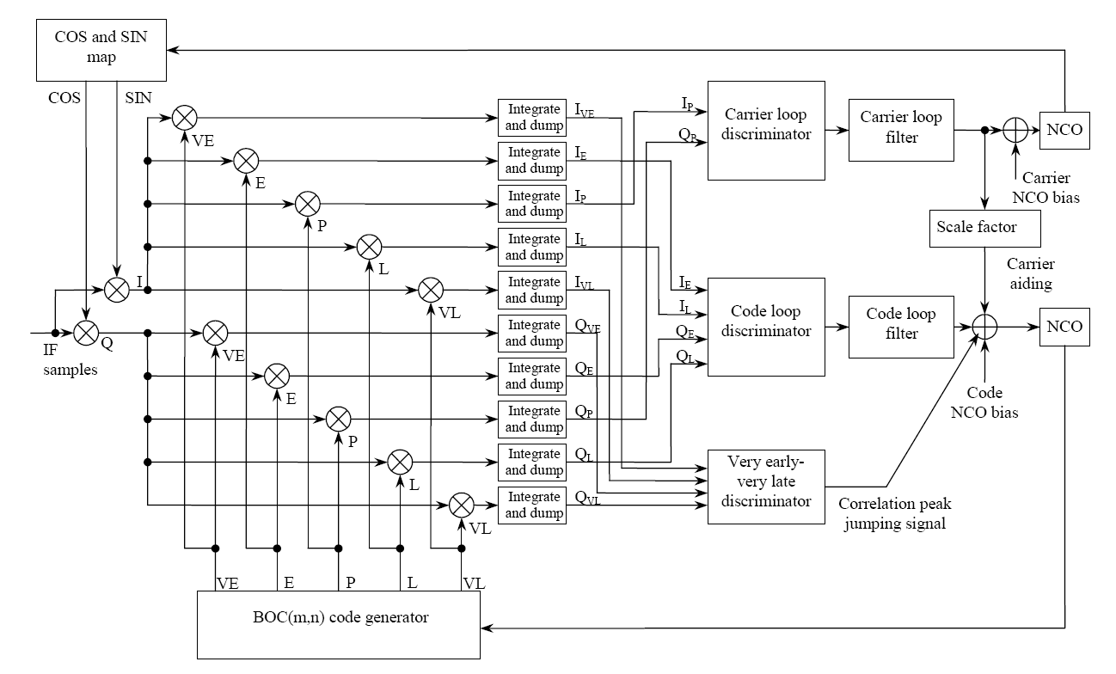
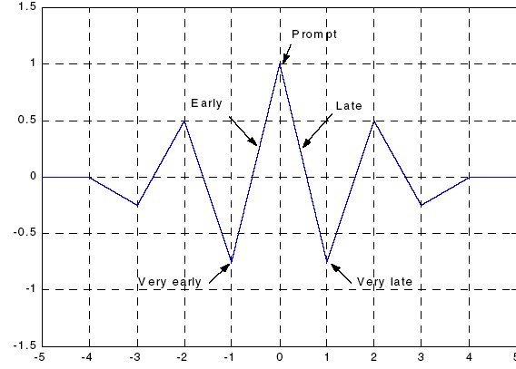
Crosscorrelation BOC(10,5) et tracking of BOC(m,n)

Slide 50
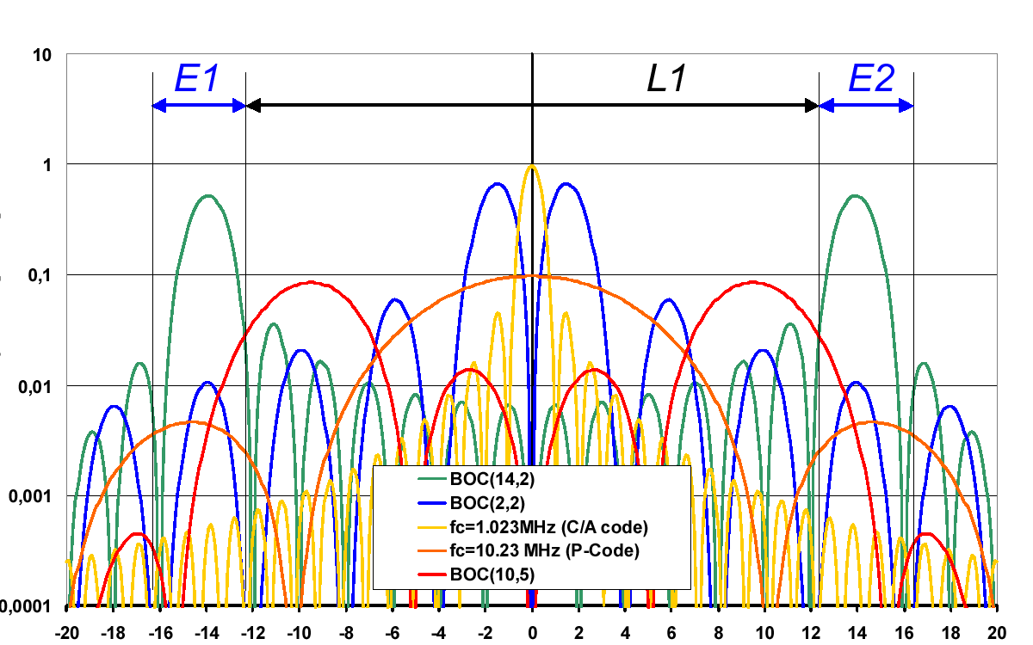
Densité spectrale de puissance PSD pour les signaux GNSS sur les bandes E1-L1-E2
Power Spectral Density PSD [W/MHz]
Fréquence [MHz]

Slide 51
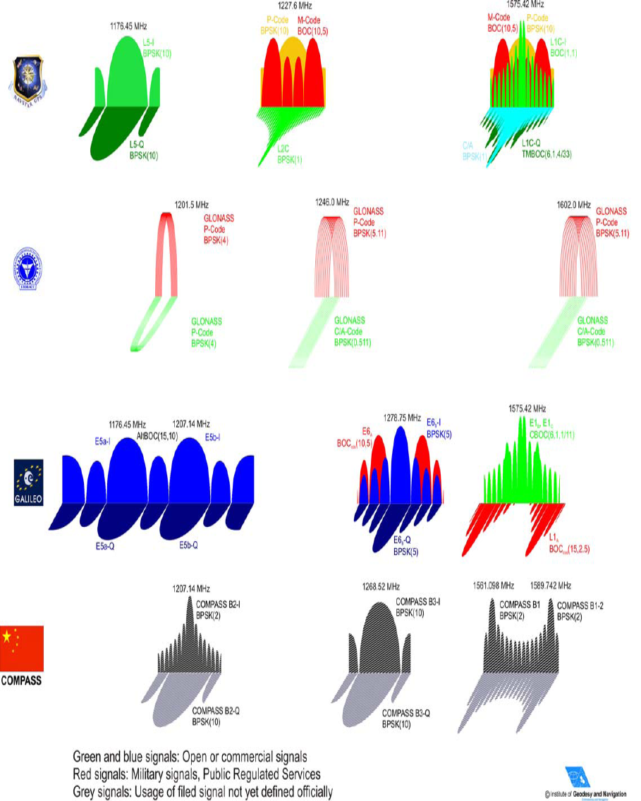
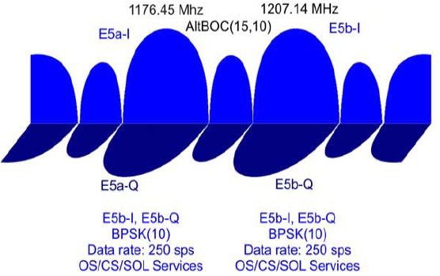
GNSS – Signaux actuels et futurs
30x1.023MHz
30x1.023MHz
30x1.023MHz
90x1.023MHz
40x1.023MHz
40x1.023MHz
Source: “GNSS Signals and Spectra,” ICG ICG-4-02, Sept.4-7, 2007
Notes:
GPS L5- At 5 a.m. PDT (Pacific Daylight Time) on April 10, 2009, first GPS L5 signal was turned on and transmitted from a GPS satellite. The L5 signal gives these users two civil signals (L1 being the other) in a protected aeronautical radionavigation services (ARNS) band. This allows for ionospheric corrections using only ARNS bands.
GPS L2: Seven IIR-Ms are now on orbit and broadcasting L2C
GIOVE A: lancé le 28.12.2005, Première transmission le 7.5.2006
GIOVE B: lancé le 27.04.2008, Première transmission le 07.05.2008
Galileo: Open Service (OS) Commercial Service (CS) Safety of Life (SoL) Public Regulated Service (PRS) Search And Rescue (SAR)
OS data, transmitted on the E5a, E5b and E1 carrier frequencies. OS data are accessible to all users and include mainly navigation data and SAR data.
- CS data transmitted on the E5b, E6 and E1 carriers. All CS data are encrypted and are provided by some service providers that interface with the Galileo Control Centre. Access to those commercial data is provided directly to the users by the service providers.
- SoL data that include mainly integrity and Signal in Space Accuracy (SISA) data. Access to the integrity data may be controlled.
- PRS data, transmitted on E6 and L1 carrier frequencies.

Slide 52
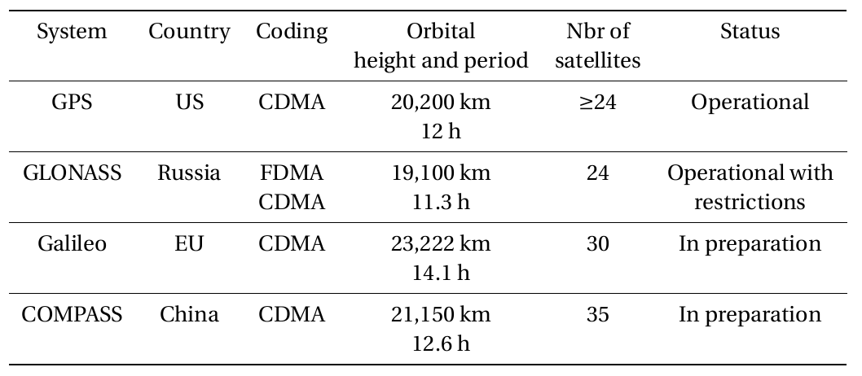
GNSS – Différents systèmes de positionnement
MEO at 21’500km
Inclined geosynchronous at 36’000km
5 Geostationary satellites
Sources:
“GPS Interface Specification IS-GPS-800 Revision A,” June 2010.
“GLONASS Interface Control Document, Navigational radio signal L1, L2,” January 2008.
“Galileo Open Service, Signal in Space Interface Control Document, OS SIS ICS, Issue 1”, September 2010.
“Current and planned global and regional navigation satellite system…”, United Nations publication, June 2010

Slide 53
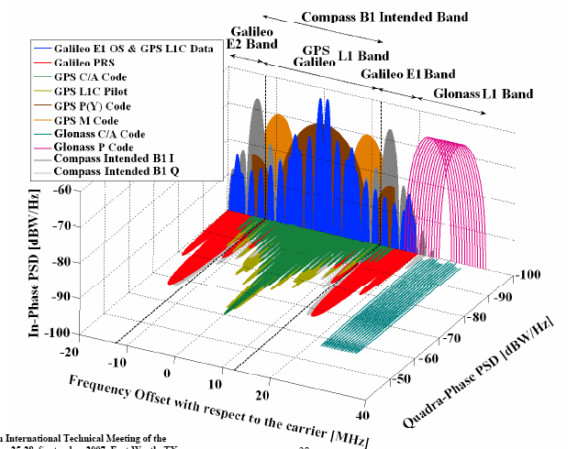
GNSS Signals in E1/L1 Band

Slide 54
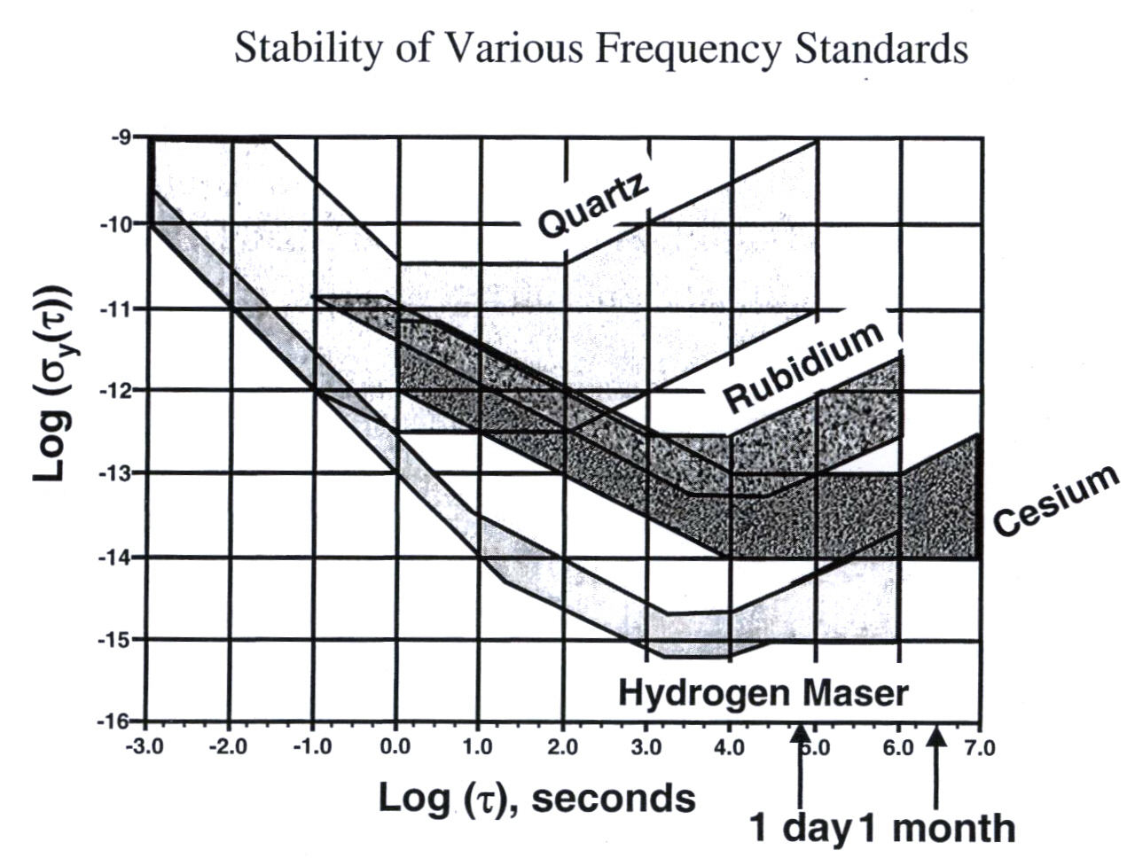
Stability of frequency standards

Slide 55
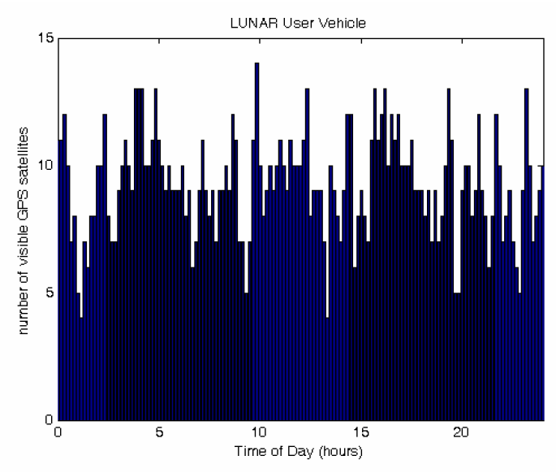
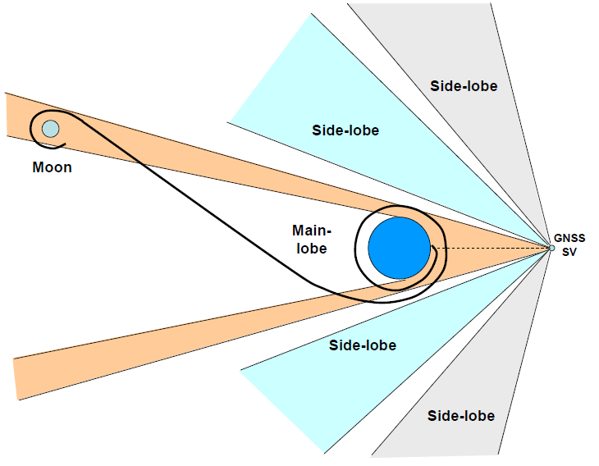
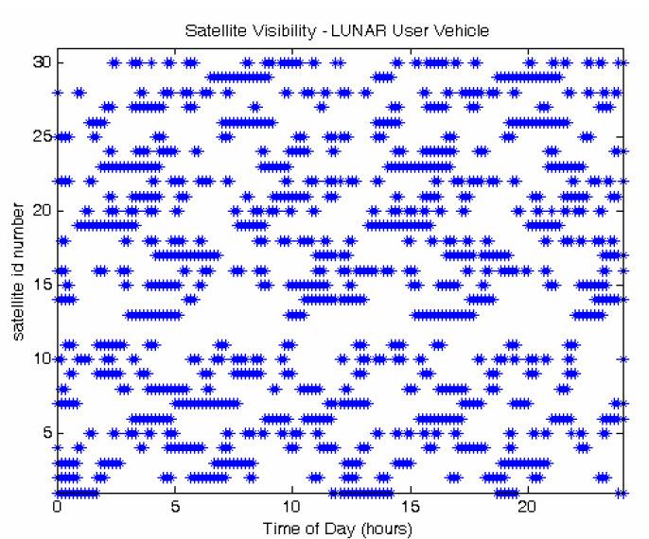
Missions lunaires – CAST “WeakHEO”
Réception de signaux GNSS pour les missions lunaires (attén. 30dB)
Nombre suffisant de satellites en vue par recours au faisceau principal et à 2 lobes secondaires !
Source: M. S. Braasch et Al., “GNSS For LEO, GEO, HEO and Beyond”

Slide 56
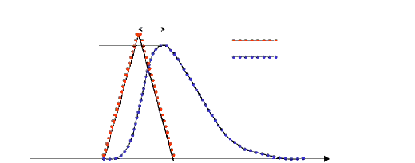



Concept de réflectométrie GNSS-R
Capter à distance (Remote sensing) les signaux GNSS réfléchis afin d’estimer les propriétés géophysiques de la surface réfléchissante.
Principes:
Les signaux GNSS sont utilisés comme signaux d’opportunité par un récepteur passif
Configuration bi-statique ou multistatique
Information délivrée :
  Retard de réflexion (hauteur)
  Caractéristiques de la surface de réflexion
Emetteur GNSS
Signal direct (RHCP)
Récepteur GNSS
Différence d’altitude (Altimétrie)
Signal réfléchi (LHCP)
Puissance max.
Signal direct
Signal réfléchi
$$h≈\frac{δ}{2\sin{(θ_{el})}}$$
Signal de corrélation
La forme et la largeur du signal de corrélation issu de la réflexion donne aussi des informations sur la rugosité et sur les propriétés électriques du sol
$$θ_{el}$$
$$θ_{el}$$
2$τ_{chip}$
Point spéculaire
Zone de scintillation
Retard (Distance)
Notes:
But what is the idea behind GNSS reflectometry.
The definition of GNSS-R is the use of GNSS reflected signals, as signals of opportunity to estimate geophysical properties from the reflecting surface.
By comparing the direct signal (RHCP) with the reflected signal, we can estimate, for example, the distance to the reflection surface, by measuring the delay difference between the two signals. This is GNSS-R altimetry.
We have multiple alternatives, using one antenna for both signals, or having two different antennas (up-looking RHCP and down-looking LHCP).
The main reflected signal power contribution is not just from the specular reflection point, but mostly from the so-called first Fresnel zone. This additional contribution not just delays, but also distorts the correlation function for the reflected signal. From the shape of this autocorrelation function, it is possible to infer the reflecting surface characteristics. Which enables the estimation of soil-moisture, sea-state and wind measurement, snow determination.
The main advantages of the GNSS-R approach is that the receiver is a passive receiver, which makes it cheaper and simpler than active receivers.
It is a bi-static or multi-static configuration (will see why multi-static configuration is so interesting).

Slide 57
SOME REFERENCES
P. Misra, P. Enge, « Global Positioning System, Signal, Measurements, and Performance », Ganga-Jamuna Press, USA, 2001.
J. Spilker, P. Axelrad, P. Enge, « Global Positioning System: Theory and Applications Volume I & II », Progress in Astronautics and Aeronautics, Volume 163, USA, 1996.
F. van Diggelen, « Indoor GPS Theory and Implementation », 2002 IEEE Position, Location and Navigation Symposium, Palm Springs, April 2002.
« GPS World », Advanstar Communications, Duluth, USA
http://www.gpsworld.com
ION – Institute of Navigation : http://www.ion.org
Navtech Seminars & GPS Supply : http://www.gpsetc.com
Galileo : http://www.esa.int/navigation

Slide 58
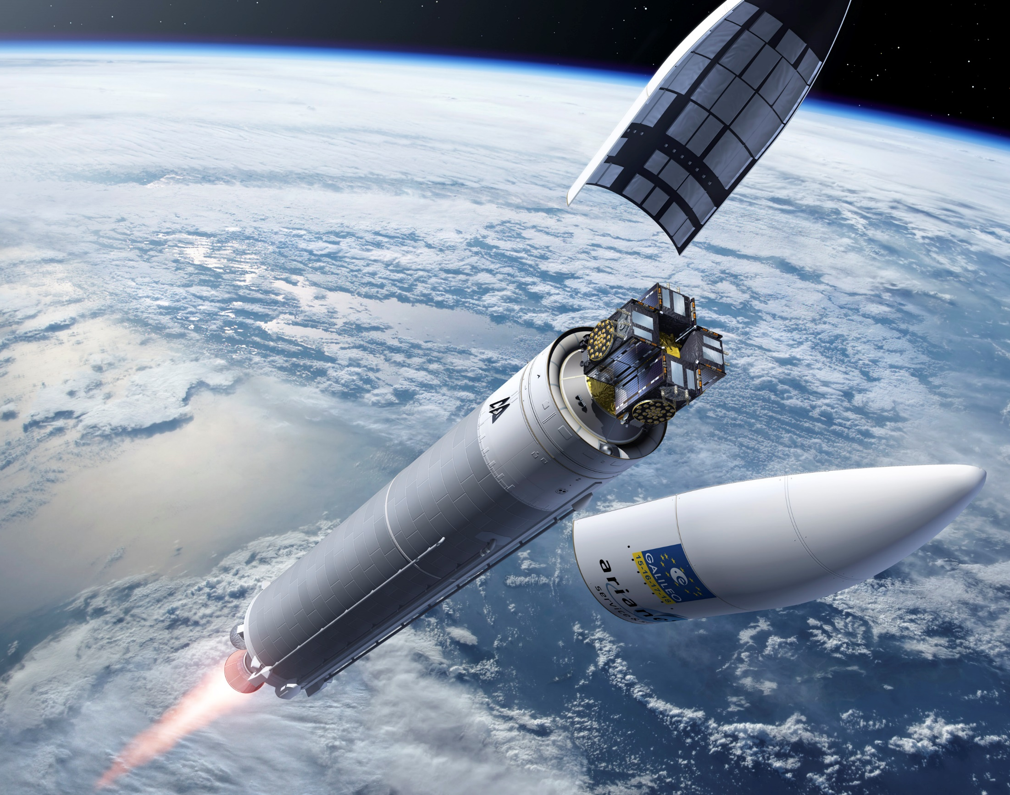
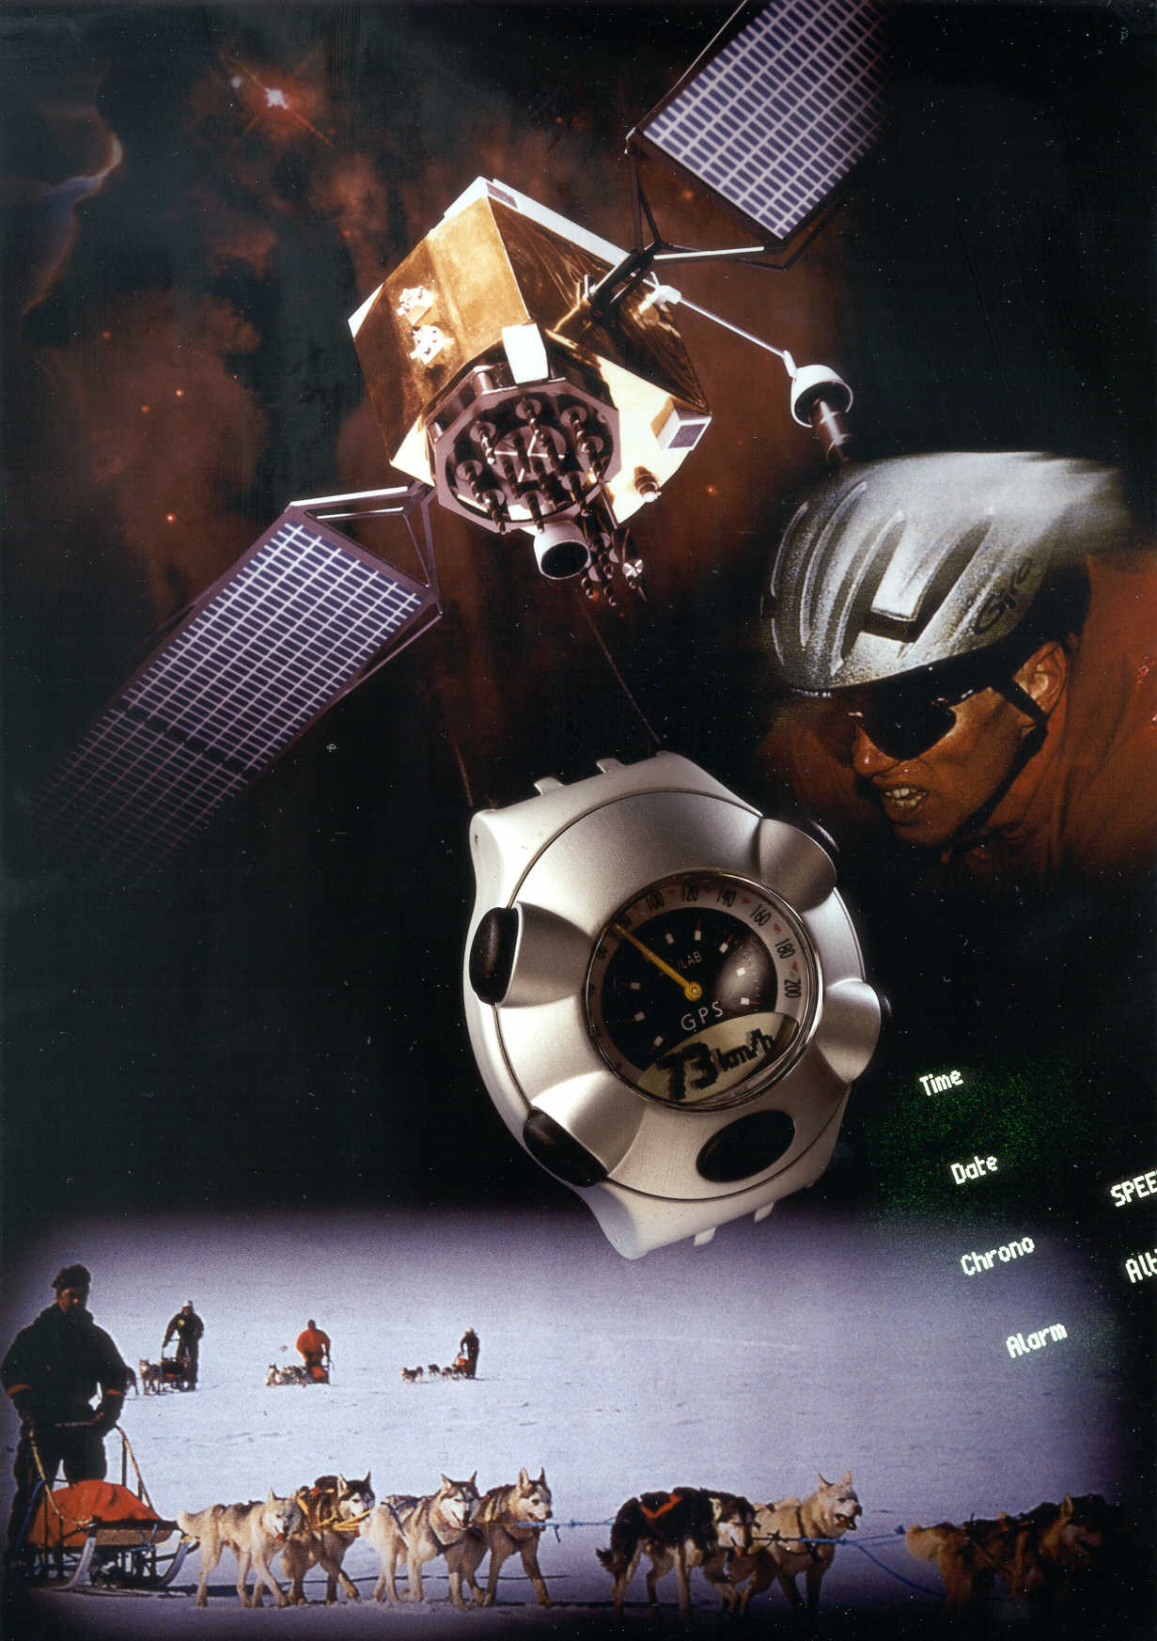
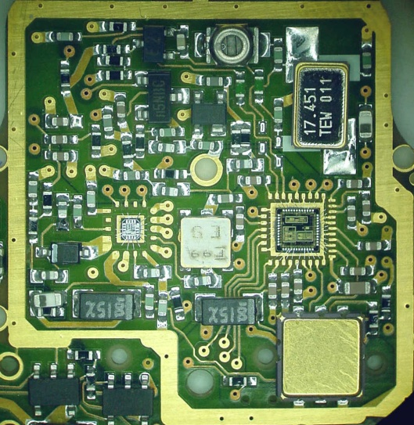
QUESTIONS ?

Slide 59
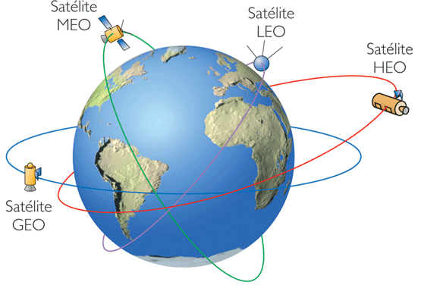
Navigation dans l’espace lointain, Définitions des orbites
Low Earth Orbit (LEO) – Orbites basses
  Platformes spatiales entre 80 km et 2000 km.
Medium Earth Orbit (MEO) – Orbites médianes
  Platform es entre 2000 km to 35’786 km
  A 20’650km, avec une période orbitale de 12 heures
Geosynchronous Orbit (GEO) - Géosynchrone
  Platform es en orbite avec une révolution d’un jour à une altitude de 35’786 km
Highly Elliptical Orbit (HEO) – Orbites élevées
  Orbite élevée terrestre : n’importe quelle orbite au-dessus de l’orbite géosynchrone (35’786 km)
  Orbite elliptique élevée HEO est une orbite de faible périgée (environ 1000 km) et une apogée supérieure à 35’786 km
Lagrangian Point Orbit (LPO) – Point de Lagrange
  Un point de l’espace au voisinage d’un système à deux corps (Terre-Lune ou Soleil-Terre) où les forces d’attraction des 2 corps se combinent de façon à ce que un 3ème corps de masse négligeable reste stationnaire par rapport aux 2 autres corps.
Projet WeakHEO – Positionnement de sondes spatiales autour et sur La Lune – Coopération EPFL avec l’Académie chinoise de technologie spatiale CAST
Satellite
Satellite
Satellite
Satellite
Source: http://gcmd.nasa.gov/User/suppguide/platforms/orbit.html
Notes:
Low Earth Orbit (LEO)
Platforms that orbit between 80 km and 2000 km.
Medium Earth Orbit (MEO)
Platform orbits lie between 2000 km to 35,786 km
Commonly at 20,200 km or 20,650, with an orbital period of 12 hours)
Geosynchronous Orbit (GEO)
Platform orbits with a revolution of exactly one day at an altitude of 35,786 km. Any orbit, which has a period equal to the Earth’s rotational period. The orbit’s eccentricity and inclination may not necessarily be zero. When the orbit is circular and the rotational period has zero inclination, the platform is considered to also be “geostationary”.
Highly Elliptical Orbit (HEO)
A High Earth Orbit is any orbit above geosynchronous (above 35,786 km). A Highly Elliptical Orbit is an orbit of low perigee (about 1000 km) and a high apogee over 35,786 km). These orbits have an inclination between 50 and 70 degrees. Highly elliptical orbits are mainly perturbed by the Earth’s oblateness and by gravitational attraction of the Sun and Moon. HEOs are popular orbits for Earth magentospheric measurements and astronomical observatories.
Lagrangian Point Orbit (LPO).
A location in space around a rotating two-body system (such as the Earth-Moon or Earth-Sun) where the pulls of the gravitating bodies combine to form a point at which a third body of negligible mass would be stationary relative to the two bodies. Lagrangian points are named after the Italian-born French mathematician and astronomer Joseph Louis de Lagrange who first showed their existence There are five Lagrangian points in all, three of which are unstable because the slightest disturbance to any object located at one of them causes the object to drift away permanently. Until recently, this meant that the unstable Lagrangian points seemed to have no practical application for spaceflight. Now, however, they are known to have immense significance and have become the basis for chaotic control. In addition, growing numbers of spacecraft are being placed in halo orbits around the L1 and L2 points; station-keeping, in the form of regular thruster firings, are needed to maintain these orbits. (Source: The Encyclopedia of Astrobiology, Astronomy and Spaceflight: http://www.daviddarling.info/encyclopedia/L/Lagpoint.html

Slide 60
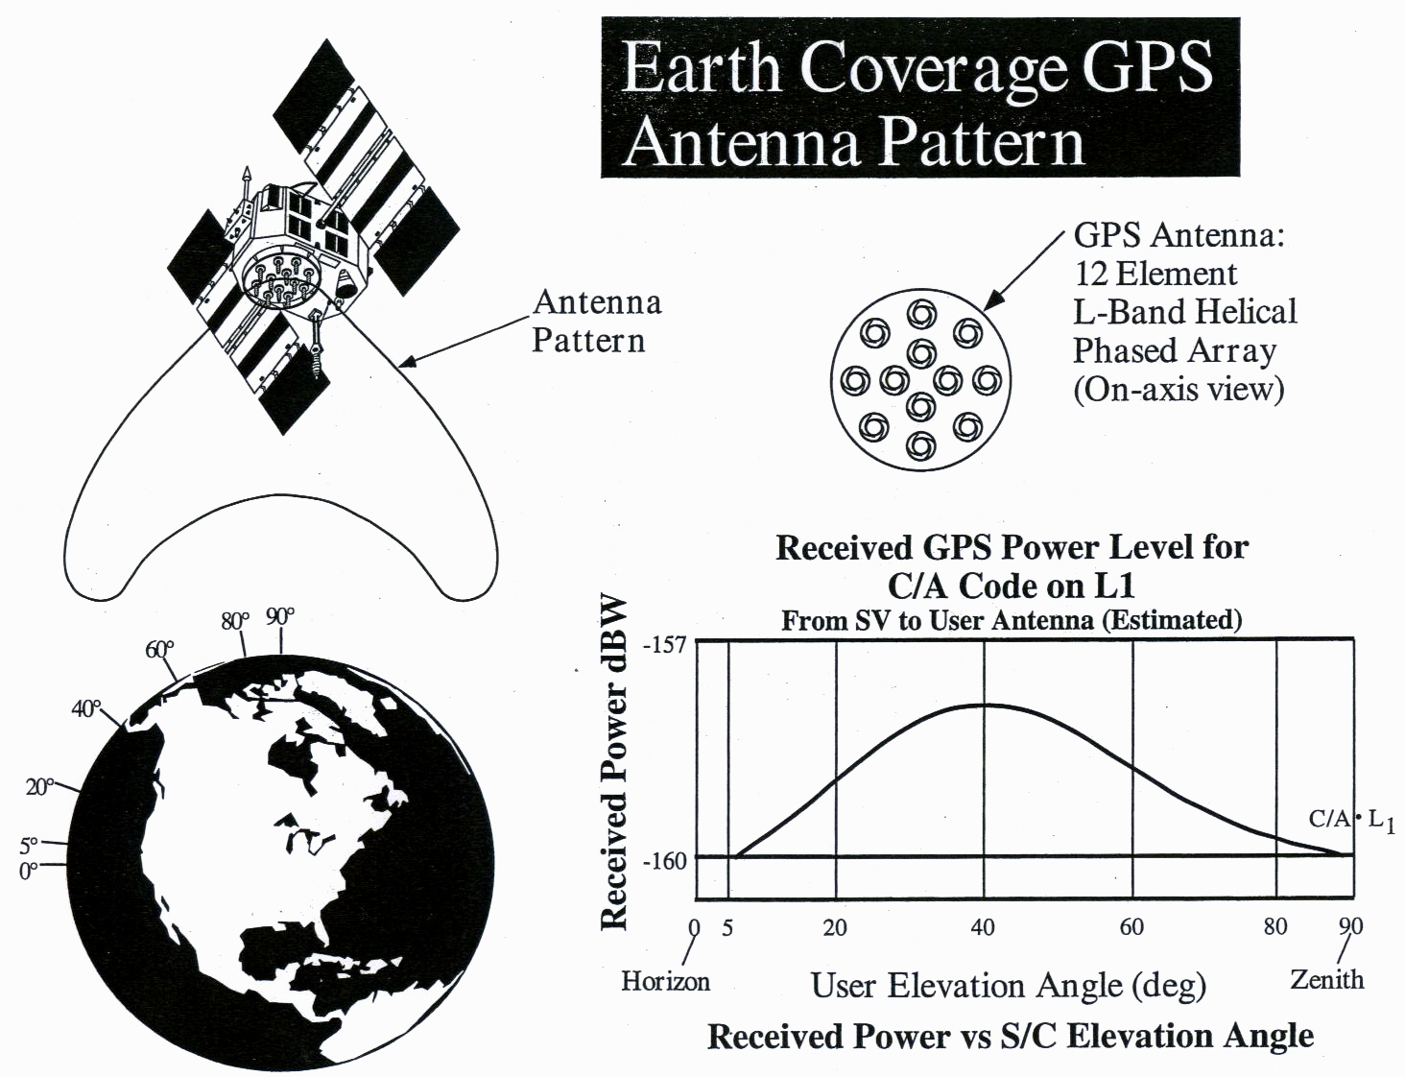
Modèle d’antenne GPS C/A et puissance reçue
Puissance transmise SV : P_{T} = 27 W Gain d’antenne SV : G_{T} = {10 to 16}
P_{T} · G_{T} = 283 to 438 W Gain antenne récepteur G_{R} = λ²/4π
Puissance reçue = P_{T}·G_{T}·G_{R}/4πR² = 10⁻¹⁶ W = -160 dBW = -130 dBm

Slide 61
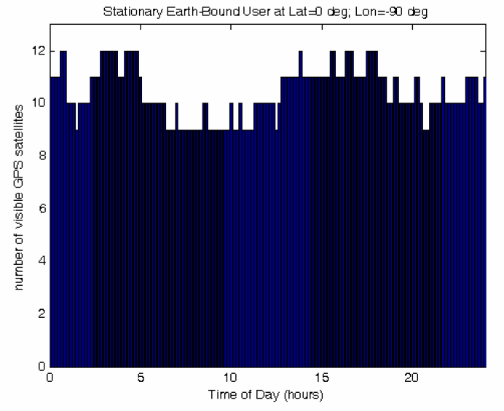
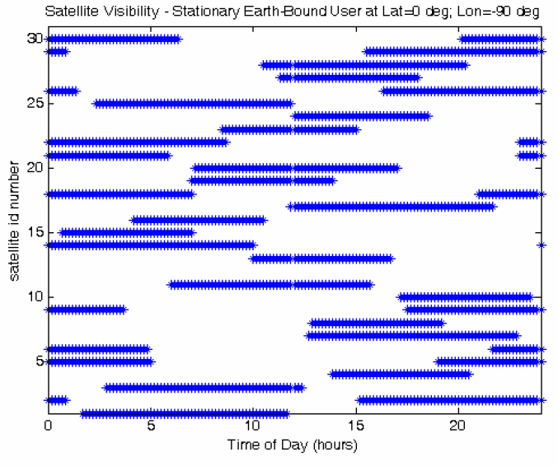
Visibilité des satellites GPS sur la Terre
Source: M. S. Braasch et Al., “GNSS For LEO, GEO, HEO and Beyond”
Angle du masque de 5 degrés

Slide 62
GNSS au-dessus des orbites médianes MEO
Recours au débordement du signal des satellites GPS à côté de la Terre
Demi-faisceau du signal principal des antennes du satellite de largeur 21.3°
Débordement de 8° du faisceau des signaux de part et d’autre de la Terre
Présence des lobes secondaires des signaux
  Généralement signaux de 15-20 dB plus faibles que les signaux transmis depuis le faisceau principal
Source: Tao Geng et al., ‘MEO and HEO Satellites Orbit Determination Based on GNSS Onboard Receiver’

Slide 63
Missions lunaires – CAST “WeakHEO”
Réception de signaux GNSS pour les missions lunaires (attén. 30dB)
Nombre suffisant de satellites en vue par recours au faisceau principal et à 2 lobes secondaires !
Source: M. S. Braasch et Al., “GNSS For LEO, GEO, HEO and Beyond”

Slide 64



GNSS - Effets des multi-trajets
1994: Un chasseur Alpha-Jet français verrouille sa position avec un signal GPS réfléchi par l’océan atlantique !
Signal Direct
Signal réfléchi
(Multi-trajet)
Les effets de distorsion des multi-trajets affectent la fonction d’auto-corrélation :
Multi-trajet avec phase > 0
Multi-trajet avec phase < 0
Source: [Img_4]
Multi-trajet : Que de mauvais effets ?
Recours à des modèles pour calculer les signaux . reçus sujets à des multi-trajets
“One man’s signal is another man’s noise”
[Edward Ng, 1990]
Notes:
Multipath is one of sources of error in GNSS and mitigating their impact is one of the main challenges in today’s GNSS research.
The received signal in the presence of multipath can be modeled as a set of signal replicas with different amplitude, delay, frequency and phase.
At the receiver, the obtained correlation against the local replica is distorted, inducing error over the determination of the peak position corresponding to the LOS contribution.
This error propagates towards the pseudorange calculation, and as a consequence to the navigation solution obtain.
How important this multipath contribution can be?
In 1994, a French Alpha-jet fighter locks onto a GPS reflected signal when overflying the Atlantic.
This mislead the jet’s navigation systems, but, at the same time contributed to prove that the GNSS reflected signal over ocean surface can be strong enough to be acquired and track.
So that are bad news for the GNSS positioning, aren’t they? But… what if we could somehow take advantage of these signals.
Remember, what it is said: “One man’s signal is another man’s noise”

Slide 65



Du multi-trajet à la réflectométrie GNSS-R
1988: Diffusiométrie multistatique proposée par Hall et Cordey (Marconi)
1993: GPS (IOC) et GLONASS déclarés opérationnels
1993: Concepts de réflectométrie passive et système d’interférométrie proposés par Martín-Neira (Brevet ESA) pour altimétrie océanique
1994: Le GPS d’un chasseur Alpha-jet se verrouille sur le signal réfléchi
1994: Premier signal GPS réfléchi mesuré dans l’espace par un instrument (SIR-C/X-SAR) à bord de la navette spatiale dans la bande L
1997-2003: Autres expériences avec d’autres applications GNSS-R
2003: Expériences spatiales GNSS-R conduites par le Royaume-Uni (UK-DMC)
Mission UK-DMC
Configuration de la mission SIR-C/X-SAR et photo de l’instrument dans la navette spatiale
Notes:
Let’s review briefly the main events that lead to the development of a new application for remote sensing using the GNSS reflected signals.
In 1988, Hall and Cordey publish a work exploring the possibility of multi-static scatterometry using GNSS signals. Fun fact, the conclusion of the paper is that the SNR and the bandwidth of GNSS signal is not good enough for remote sensing applications.
In 1993, same year that GPS and GLONASS are declared operational, Manuel Martín-Neira from ESA proposes the Passive Reflectometry and Interferometry System (PARIS) concept to use the reflected GPS signals for ocean altimetry.
1994, was a big year for serendipity, in addition to the jet incident, the GPS signal is measured for first time from space when testing the radiometer SIR-C/X-SAR instrument working on the L-band from the Space Shuttle.
After this, the research community became interested in the topic and from 1997-2003, they start proposing GNSS-R for other applications beyond ocean altimetry.
Finally, in 2003, the UK-Disaster Monitoring Center performs the first GNSS-R experiment from space.

Slide 66
Concept de réflectométrie GNSS-R
Capter à distance (Remote sensing) les signaux GNSS réfléchis afin d’estimer les propriétés géophysiques de la surface réfléchissante.
Principes:
Les signaux GNSS sont utilisés comme signaux d’opportunité par un récepteur passif
Configuration bi-statique ou multistatique
Information délivrée :
  Retard de réflexion (hauteur)
  Caractéristiques de la surface de réflexion
Emetteur GNSS
Signal direct (RHCP)
Récepteur GNSS
Différence d’altitude (Altimétrie)
Signal réfléchi (LHCP)
Puissance max.
Signal direct
Signal réfléchi
$$h≈\frac{δ}{2\sin{(θ_{el})}}$$
Signal de corrélation
La forme et la largeur du signal de corrélation issu de la réflexion donne aussi des informations sur la rugosité et sur les propriétés électriques du sol
$$θ_{el}$$
$$θ_{el}$$
2$τ_{chip}$
Point spéculaire
Zone de scintillation
Retard (Distance)
Notes:
But what is the idea behind GNSS reflectometry.
The definition of GNSS-R is the use of GNSS reflected signals, as signals of opportunity to estimate geophysical properties from the reflecting surface.
By comparing the direct signal (RHCP) with the reflected signal, we can estimate, for example, the distance to the reflection surface, by measuring the delay difference between the two signals. This is GNSS-R altimetry.
We have multiple alternatives, using one antenna for both signals, or having two different antennas (up-looking RHCP and down-looking LHCP).
The main reflected signal power contribution is not just from the specular reflection point, but mostly from the so-called first Fresnel zone. This additional contribution not just delays, but also distorts the correlation function for the reflected signal. From the shape of this autocorrelation function, it is possible to infer the reflecting surface characteristics. Which enables the estimation of soil-moisture, sea-state and wind measurement, snow determination.
The main advantages of the GNSS-R approach is that the receiver is a passive receiver, which makes it cheaper and simpler than active receivers.
It is a bi-static or multi-static configuration (will see why multi-static configuration is so interesting).

Slide 67



Applications GNSS-R
Concept ayant recours à une plateforme aéroportée/spatiale :
Paramètre estimé :
Applications
Altimétrie
Altimétrie océanique (i.e. PARIS)
Altimétrie des sols
Granularité
Détermination de l’état de la mer
Paramètres liés à la permittivité (humidité, température, salinité)
Humidité du sol
Vents de surface des mers
Mesure d’épaisseur de la glace
Monitoring de la biomasse et de la végétation
Manteau neigeux
Source: [Img_10]
Récupération des paramètres de permittivité en surface par des plateformes terrestres
Notes:
Here a brief summary of the GNSS-R so-far existing GNSS-R applications classified depending on the parameter that it is estimated:
Altimetry, the distance between the receiver and the reflecting surface is estimated. Here we have ocean altimetry, (such as the PARIS project from airborne or space platforms) and ground platforms altimetry.
If we estimate the roughness of the surface we can determinate the sea-state or the intensity and direction of the wind over water surface
Finally, the last group of applications estimate the permitivy parameters of the reflecting suface, such as humidity, temperatura or salinity. This allows to estimate the soil-moisture, the snow content, ice sensing, estimate the vegetation avaiable.
In the picture here we see how for a ground platform, how SNR or C/N_0 (equivlantely) obtained due to the interference of the direct and reflected signals changes depending on the existence of an snow layer, vegetation of the humidity of the soil.

Slide 68





Missions spatiales GNSS-R planifiées
Cyclone GNSS (CYGNSS)
Mesures précises et fréquentes des vents en surface des océans au cours des cycles de tempêtes tropicales et d’ouragans
Etude de la diffusion
Date prévue du lancement : Octobre 2016
GEROS - GNSS REflectometry, Radio Occultation and Scatterometry
Etudes depuis la station ISS International Space Station
Déduction d’informations concernant les changements du climat
Planifiée par l’ESA
Notes:
Finally, we present here 2 planned space missions using GNSS-R.
The NASA’s Cyclone GNSS, a small constellation of 8 small satellites for measuring ocean surface winds on storms and hurricanes.
And the GEROS experiment on board of the ISS, for earth measurements on climate change.
The key features of GNSS-R for space applications are:
A GNSS-R instrument is a passive receiver -> Reduces power budget
And most important, the multi-static configuration, where the tracks of multiple satellites are simultaneously processed allowing to sweep larger regions in much shorter times compared to traditional active monostatic instruments.

Slide 69

Part 3 : Indoor GPS High sensitivity

Slide 70
GPS C/A Antenna Pattern and Received Power
SV Transmitted Power P_{T} = 27W SV Antenna Gain G_{T} = {10 to 16}
P_{T} * G_{T} = 283 to 438 W Receiver Antenna Gain G_{R} = λ²/4π
Received Power = P_{T}G_{T}G_{R}/4πR² = 10⁻¹⁶ W = -160 dBW = -130 dBm

Slide 71

Indoor GPS
Code/phase frequency
Indoor GPS searches all the code phases simultaneously.
In combination with A – GPS, the acquisition phase becomes 1000 to 10000 times quicker than GPS – standard.
The acquisition may be operating 1000 to 10000 longer, resulting in a enhanced sensitivity (weaker signals -20dB to -30dB may be detected).
Code/phase
Frequency
Real time GPS Indoor. Search in frequency-
-code/phase plane for the correlation max.

Slide 72


I - Q, and non-coherent integration

Slide 73

Coherent vs Non-coherent - Squaring loss

Slide 74

Correlation with Coherent or
Non-coherent Integration

Slide 75

GPS Indoor – Convolution processor

Slide 76


Indoor GPS : Aiding + Massively parallel correlation coherent & non-coherent

Slide 77

Navigation Satellite Systems

Slide 78

GNSS L-Band Signals

Slide 79



EPFL IMT-NE ESPLAB
Laboratoire d’électronique et de traitement du signal 32 collaborateurs
by JBa, 21.05.2012
Merci pour votre attention !

Slide 80







EPFL ESPLAB GNSS Group
Projects History
T: Theory
S: Software
V: VHDL
C: COTS
A: ASIC
EU-FP6
GRDB
05-07 (V/S)
EU-FP7
SIGNATURE
09-10 (V)
CAST (SPACE AGCY)
WeakHEO
13-15 (T/S/V)
CTI
GPS L1/L2
04-07 (V/A/S/C)
EU FP7 SARBACAN
09-10 (T)
Main achievements:
New adaptive tracking techniques for BOC signal
Semi-analytical simulation framework for fast analysis
u-blox
JOTAN
07-09 (T/S)
CTI
GPS WATCH
-04 (V/A/S/C)
EU-FP7
GAMMA-A
09-12 (T/S)
ESA
ADAPT
13-14 (T/S)
SNSF
GNSS1
08-11 (T/M/C)
SNSF
GNSS2
11-12 (T/M)
PSD of BOCs(15, 2.5) and BOCc (15, 2.5) signals
Autocorrelation function of BOCc(15, 2.5) modulation

Slide 81





EPFL ESPLAB GNSS Group
Projects History
T: Theory
S: Software
V: VHDL
C: COTS
A: ASIC
EU-FP6
GRDB
05-07 (V/S)
EU-FP7
SIGNATURE
09-10 (V)
CAST (SPACE AGCY)
WeakHEO
13-15 (T/S/V)
Main achievements:
Use GNSS reflected signals as signals of opportunity for Earth sensing
Deep analysis of improved IPT (Interference Pattern Technique)
1 PhD work ongoing
CTI
GPS L1/L2
04-07 (V/A/S/C)
EU FP7 SARBACAN
09-10 (T)
u-blox
JOTAN
07-09 (T/S)
CTI
GPS WATCH
-04 (V/A/S/C)
EU-FP7
GAMMA-A
09-12 (T/S)
ESA
ADAPT
13-14 (T/S)
GNSS
Transmitter
Direct Signal (RHCP)
SNSF
GNSS1
08-11 (T/M/C)
SNSF
GNSS2
11-12 (T/M)
SNSF
GNSS3/REFLECTO
14-17 (T/M)
GNSS
Receiver
Reflected
Signal (LHCP)
$$h≈\frac{δ}{2\sin{(θ_{el})}}$$
$$θ_{el}$$
$$θ_{el}$$
Specular Point
Glistening zone
M.-A. Ribot, “GNSS-Reflectometry Signal Processing and Receiver Design” , EPFL PhD candidate

Slide 82











EPFL ESPLAB GNSS Group
Projects History
T: Theory
S: Software
V: VHDL
C: COTS
A: ASIC
EU-FP6
GRDB
05-07 (V/S)
EU-FP7
SIGNATURE
09-10 (V)
CAST (SPACE AGCY)
WeakHEO
13-15 (T/S/V)
Main achievements:
Low power front-end ASIC (180 nm) for Galileo PRS receivers
Concurrent reception of E1 and E6 bands
Up to 50 MHz BW per channel
1 PhD work ongoing
CTI
GPS L1/L2
04-07 (V/A/S/C)
EU FP7 SARBACAN
09-10 (T)
FP7
ARMOURS
12-14 (A)
u-blox
JOTAN
07-09 (T/S)
UWB/mm/
CSAC
CTI
GPS WATCH
-04 (V/A/S/C)
EU-FP7
GAMMA-A
09-12 (T/S)
ESA
ADAPT
13-14 (T/S)
SNSF
GNSS1
08-11 (T/M/C)
SNSF
GNSS2
11-12 (T/M)
SNSF
GNSS3/REFLECTO
14-17 (T/M)
S. Ghamari, “CMOS ASIC Design of a Multi-Frequency Multi-Constellation GNSS Front-End”, EPFL PhD candidate

Slide 83



EPFL ESPLAB GNSS Group
Projects History
T: Theory
S: Software
V: VHDL
C: COTS
A: ASIC
EU-FP6
GRDB
05-07 (V/S)
EU-FP7
SIGNATURE
09-10 (V)
CAST (SPACE AGCY)
WeakHEO
13-15 (T/S/V)
Current development:
Low power front-end ASIC (180 nm) for Beidou B1/GPS L1 (single channel or concurrent reception of B1 and L1 bands)
High sensitivity and interference mitigation algorithms
CTI
GPS L1/L2
04-07 (V/A/S/C)
EU FP7 SARBACAN
09-10 (T)
FP7
ARMOURS
12-14 (A)
WELLCORES
BEIDOU
14-15 (A,V,S)
u-blox
JOTAN
07-09 (T/S)
UWB/mm/
CSAC
CTI
GPS WATCH
-04 (V/A/S/C)
EU-FP7
GAMMA-A
09-12 (T/S)
ESA
ADAPT
13-14 (T/S)
SNSF
GNSS1
08-11 (T/M/C)
SNSF
GNSS2
11-12 (T/M)
SNSF
GNSS3/REFLECTO
14-17 (T/M)

Slide 84

Perspective historique de la détermination du temps
La métamorphose de la mesure du temps
Précision / Stabilité
[secondes/jour]
Horloges
Atomiques
(1950),
Maser à
Hydrogène,
Horloges
au Césium,
au Rubidium
Chronomètres Horloges atomiques
de marine spatiales
Oscillateurs à quartz (1930)
Rotation de la Terre
Chronomètres de marine
(1750), Harrison
Pendule de Huygens (1650), Huygens
Horloges de clocher (1300) mécanisme à verge et foliot

Slide 85




Sur quel principe physique fonctionne une horloge atomique?
L’énergie d’un atome ne peut prendre qu’un certain nombre de valeurs discontinues croissantes : $E_{p}$, $E_{n}$,… appelés niveaux d’énergie.
Pour faire passer un atome d'un niveau d'énergie $E_{p}$ à un autre plus élevé $E_{n}$(on parle de transition atomique), il faut lui fournir de l’énergie. Par exemple, il peut absorber un photon d’énergie $hν_{o}$, ou $h$est la constante de Planck (6,62607004 × 10⁻³⁴ m² kg / s) et $ν_{o}$ est la fréquence associée au photon.
Inversement, lorsqu’un atome passe d’un niveau d’énergie $E_{n}$ à un niveau inférieur d ‘énergie $E_{p}$ un photon d’énergie $hν_{o}$ est émis. Toute l’énergie que l’atome a perdu se retrouve dans le photon émis. Le principe de conservation de l’énergie appliqué à l’atome conduit à :
$$hν_{o}=E_{n}−E_{p}$$
Une horloge atomique analysera donc l’onde électromagnétique ayant provoqué le changement d'état d'atomes afin de caler l’oscillateur local sur la fréquence de transition atomique.
Boucle de contrôle
Oscillateur local
Référence atomique
$$ν_{o}$$
$$ν_{o}$$
Interrogation
Notes:
Image absorption emission de http://tempsatomique.chez.com/nouvellepage3.htm

Slide 86
L’horloge atomique miniature réalisée en partenariat avec l’EPFL ESPLAB
En physique atomique, un état sombre se réfère à un état d'un atome ou d'une molécule qui ne peut pas absorber (ou émettre) des photons.
Un état sombre peut être le résultat d'interférence quantique dans un système à trois niveaux, quand un atome est dans une superposition cohérente de deux Etats, qui sont tous deux couplés par des lasers à la bonne fréquence à un troisième état.
Dans une horloge atomique miniature qui se base sur cet effet (« coherent population trapping » en anglais), c’est l’état sombre qui est ainsi obtenu qui sert à asservir l’oscillateur local (ici un quartz de 10 MHz dont la fréquence peut être contrôlée par une tension provenant de la boucle d’asservissement)
Notes:
La fréquence de ~4.6 GHz sert à moduler la fréquence laser et ainsi produire 2 fréquences espacées de ~9.2 GHz

Slide 87

La définition de l’unité de la seconde
¹ Brochure sur le SI, 8ème edition
La seconde est l'unité du SI la plus précisément connue¹
Elle a d'abord été définie comme une fraction du jour solaire terrestre moyen (1/86 400). L'échelle de temps associée est le Temps Universel (TU).
En 1960, pour tenir compte des imperfections de la rotation de la terre, elle devient basée sur la révolution de la Terre autour du Soleil (définie comme la fraction 1/31 556 925,9747 de l’année tropique 1900).
En 1967, la seconde n’est plus définie par rapport à l’année, mais par rapport à une propriété de la matière. La définition de l’unité de temps devient la durée de 9 192 631 770 périodes de la radiation correspondant à la transition entre les deux niveaux hyperfins de l’état fondamental de l’atome de césium 133, i.e., un multiple de la période de l’onde émise par un atome de césium 133 lorsqu’un de ses électrons change de niveau d’énergie.
Le temps atomique international (TAI) est la référence mondiale fondée sur la définition de la seconde atomique, calculée au Bureau international des poids et mesures à Sèvres, en faisant la moyenne de plus de 400 horloges atomiques (en 2013) réparties dans plus de 70 laboratoires dans le monde.
Notes:
Image soleil de : http://omnilogie.fr/O/Jour_solaire,_jour_stellaire

Slide 88

Atomic clocks - Constitutive parts

Slide 89




















Spectratime atomic clocks in 2017
COMPOSANTS
SYSTÈMES
iSource+®
iSpace+™
iSync+®
iReference+®
iTest+®
Rb Oscillators
Low SWaP Oscillators
GPS/GNSS Rb OCXO Oscillators
GPS/GNSS Rb OCXO Standards
Clock Instruments
OCXO
GPS-locked Rb
1ps ADEV
GPS-locked Rb
Rb
GPS Rb & LN OCXO
GPS Rb & 1ps ADEV
GPS Rb or OCXO
Active Maser
Chip Scale Atomic Rb
MiniRb
GPS-locked Rb & LN OCXO
iMaser/P/G
PMs
100fs Synthesizer

Slide 90






Spectratime space atomic clocks in 2017 and future devices
Type | Atome | Masse | TRL | Remarque
Active Maser | H | 40kg | 8 | Science missions
Passive Maser | H | 12-18kg | 9 | 25 units flying on 13 satellites
Ion-trap | Hg | 5-6kg (tbd) | 4 | Future navigation satellites systems
RAFS | Rb | 3.2kg | 9 | 74 units flying on 39 satellites
Mini-RAFS | Rb | 0.4kg | 8 | Spectral lamp
MTS | Rb | <0.1kg | 5 | Laser

Slide 91



Accuracy, Trueness and Precision
“Exactitude, véracité et précision”
Low accuracy,
poor precision,
good trueness
Low accuracy,
good precision,
poor trueness
According to ISO 5725-1, accuracy consists of trueness (or bias, proximity of measurement results to the true value) and precision (repeatability or reproducibility of the measurement).
Accuracy is the proximity of measurement results to the true value; precision, the repeatability, or reproducibility of the measurement.

Slide 92

GPS -
15.03.2017

Slide 93
Radio frequency bands
Band Name | Frequency Range | Wavelength Range | Notes
HF | 3–30 MHz | 10–100 m | coastal radar systems, over the horizon radar (OTH) radars; 'high frequency'
P | < 300 MHz | 1 m+ | 'P' for 'previous', applied retrospectively to early radar systems
VHF | 50–330 MHz | 0.9–6 m | very long range, ground penetrating; 'very high frequency'
UHF | 300–1000 MHz | 0.3–1 m | very long range (e.g. ballistic missile early warning), ground penetrating, foliage penetrating; 'ultra high frequency'
L | 1–2 GHz | 15–30 cm | long range air traffic control and surveillance; 'L' for 'long'
S | 2–4 GHz | 7.5–15 cm | terminal air traffic control, long-range weather, marine radar; 'S' for 'short'
C | 4–8 GHz | 3.75–7.5 cm | Satellite transponders; a compromise (hence 'C') between X and S bands; weather
X | 8–12 GHz | 2.5–3.75 cm | missile guidance, marine radar, weather, medium-resolution mapping and ground surveillance; in the USA the narrow range 10.525 GHz ±25 MHz is used for airport radar. Named X band because the frequency was a secret during world war 2.
K_{u} | 12–18 GHz | 1.67–2.5 cm | high-resolution mapping, satellite altimetry; frequency just under K band (hence 'u')
K | 18–27 GHz | 1.11–1.67 cm | from German kurz, meaning 'short'; limited use due to absorption by water vapor, so K_{u} and K_{a} were used instead for surveillance. K-band is used for detecting clouds by meteorologists, and by police for detecting speeding motorists. K-band radar guns operate at 24.150 ± 0.100 GHz.
K_{a} | 27–40 GHz | 0.75–1.11 cm | mapping, short range, airport surveillance; frequency just above K band (hence 'a') Photo radar, used to trigger cameras which take pictures of license plates of cars running red lights, operates at 34.300 ± 0.100 GHz.
mm | 40–300 GHz | 7.5 mm – 1 mm | millimeter band, subdivided as below. The frequency ranges depend on waveguide size. Multiple letters are assigned to these bands by different groups. These are from Baytron, a now defunct company that made test equipment.
Q | 40–60 GHz | 7.5 mm – 5 mm | Used for Military communication.
V | 50–75 GHz | 6.0–4 mm | Very strongly absorbed by the atmosphere.
E | 60–90 GHz | 6.0–3.33 mm
W | 75–110 GHz | 2.7 – 4.0 mm | used as a visual sensor for experimental autonomous vehicles, high-resolution meteorological observation, and imaging.

